Slide 1


THIRUVALLUVAR UNIVERSITY
RED RIBBON CLUB (RRC)
SERKKADU, VELLORE 632 115, TN, INDIA
DETAILS OF RED RIBBON CLUB ACTIVITIES CONDUCTED IN THE THIRUVALLUVAR UNIVERSITY
FROM 2012 TO 2017 SUBMITTED BY DR.K.SIVACHANDRABOSE, PROGRAMME COORDINATOR,
RED RIBBON CLUB (RRC)
CHAIRPERSON : PROF. DR. K. MURUGAN, D.Sc
REGISTRAR I/C : DR. V. PERUVALLUTHI
PROGRAMME COORDINATOR : DR.K.SIVACHANDRABOSE
PROGRAMME IMPLEMENTING AUTHORITY IN THE STATE LEVEL : PROJECT DIRECTOR, TAMILNADU STATE ADIS CONTROL SOCIETY CHENNAI (TANSACS)

Slide 2
Vision
To make HIV/AIDS free India by creating awareness about the spread and cause of HIV/AIDS among the student youth , non-student youth and public.
Objectives
To reduce new HIV infection among youth by raising their risk perception through Life Skill Education and creating awareness on Sex, Sexuality and HIV/AIDS.
1. To induce among youth the spirit to help and support people living with HIV/AIDS (PLWHA) thereby reducing stigma and discrimination against people living with HIV/AIDS.
2. To motivate youth and build their capacity as peer educators and change agents by developing their skills on leadership, negotiation and team building.
3. To promote voluntary non- remunerated blood donation among youth

Slide 3
RC regular activities being carried out at the college level
Imparting 6 to 10 hour sessions on the curriculum “ Celebrating Life”
Peer education and leadership training
Competitions (Debates, Quiz, Drawing and Painting)
Interactions with positive people
Interaction with ICTC, ART, Blood Bank Medical Officers and Counselors and Transgender
Peer leaders conventions
Awareness campaigns ( rallies, out reach activities) and exposure visit
Mandatory program
Blood Donation camp – being donated to the govt. and approved hospitals and also needy people
Regular RRC activities being carried out at the University level
Trainers trainee program for RRC Program officers
Peer education training program for RRC volunteer
District wise trainers trainee program conducted at four district with different dates
Celebrating life module program conducted for university students
RRC volunteers certificates distributed to all RRC colleges affiliated to the university

Slide 4
2012-2018
Name of the activity | Name of the scheme | Year of activity | Number of teachers participating | Number students participating
Celebrating life training programme for RRC Programme Officers | RRC | 2012 | 66 | Nil
RRC Programme officers trainer’s trainee programme | RRC | 2013 | 98 teachers from 98 affiliated colleges | Nil
RRC volunteers peer educators programmes | RRC | 2013 | 30 – 40 | 490
One Day Enrichment Traiing programme for RRC Programme Officers | RRC | 2014 (14.2.2014) | 80 | Nil
Volunteers peer educator training programme | RRC | 2014 (15.2.2014) | 20 | 150
RRC POs training programme | RRC | 2015 (13.3.2017) | 85 | Nil
International Youth Day for RRC Volunteers | RRC | 2017 | 40 | 350
Observance of World AIDS Day | RRC | 1st December,2017 | University staff 50 | 50
 | Observance of World AIDS Day is conducted by all affiliated colleges of Thiruvalluvar university
 | Percentage per year: 73%

Slide 5
Note:
Apart from the activities on RRC Programme Officers and RRC volunteers training programme from the University side, routine activities like awareness on HIV/AIDS, sex and sexuality and gender issues, voluntary blood donation camp, celebrating life session, peer education programme, International Youth Day, World AIDS Day, rally and human chain and other related activities are being conducted in all the 98 colleges functioning with 98 RRC units since 2012 to till date. These activities are being monitored by the respective colleges,Red Ribbon Club Cell of the Thiruvalluvar university, TANSACS, Chennai and staffs under District Administration. Each RRC unit per college contain 100 volunteers and more.
Details of RRC units functioning in the 98 affiliated colleges of the University
Note: PO indicates Programme Officers of the college and they are the Programme implementing coordinator in the college level. During the year 2017-2018, 18 more new RRC units allotted to the affiliated colleges. Now there are 116 RRC units functioning in the Thiruvalluvar university and its affiliated colleges.
S.No. | Name of the District | Number of colleges | Number of RRC Units | Number of RRC PO | Number of volunteers
1. | Vellore | 31 | 31 | 31 | 3,100
2. | Thiruvannamalai | 22 | 22 | 22 | 2,200
3. | Villupuram | 29 | 29 | 29 | 2,900
4. | Cuddalore | 16 | 16 | 16 | 1,600
 | Total | 98 | 98 | 98 | 9,800

Slide 6
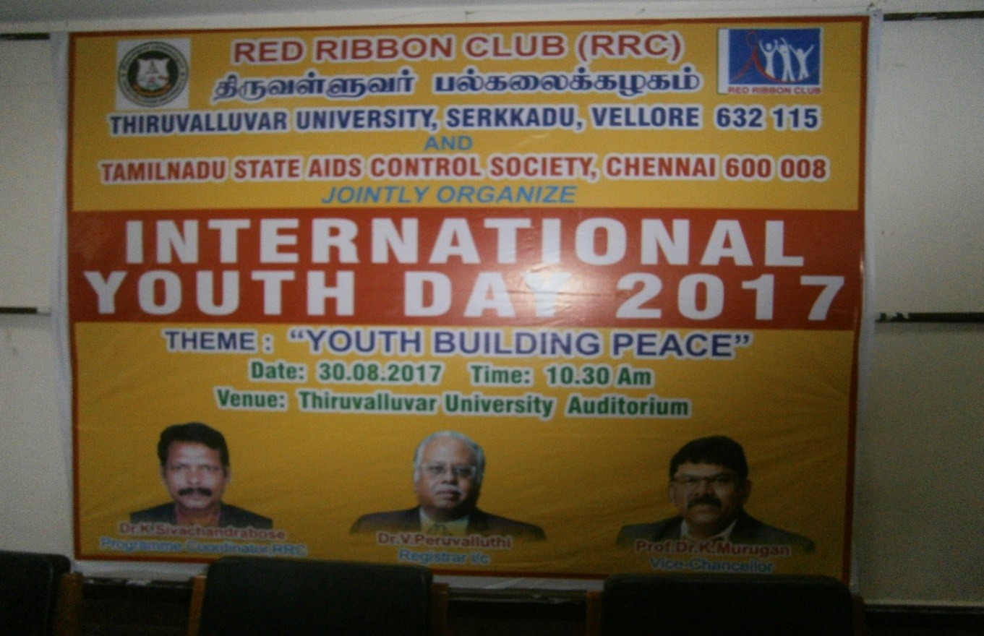
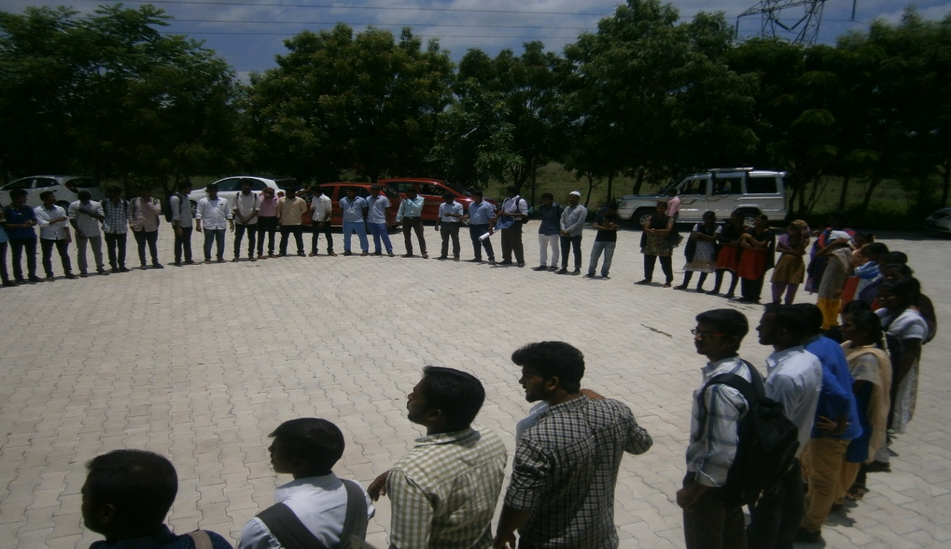
2017 -2018
Structure of Red Ribbon was formed by the student volunteers and RRC Functionaries in the Thiruvalluvar University campus to observe the World Aids Day, 2017 on 1st December, 2017.

Slide 7
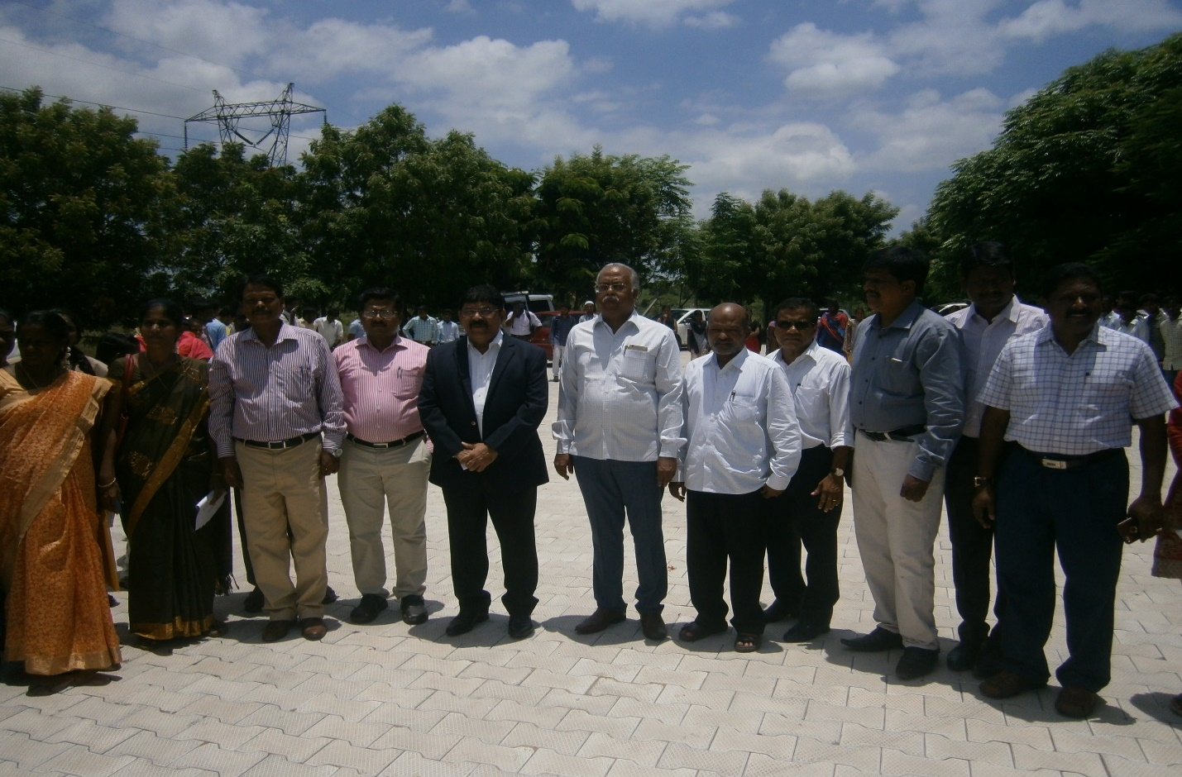
Hon’b;e Vice-Chancellor of the Thiruvalluvar University Dr.K.Murugan,D.Sc, Registrar i/c Dr.V.Peruvalluthi, Programme Coordinator,RRC Dr.K.Sivachandrabose, Dr.K.S.T. Suresh, DDHS,Vellore and Dr.Munavar john, Syndicate Member (Former), University Professors,Students, representative from Collectorate, RRC volunteers and RRC Programme Officers are seen in the photograph of Red Ribbon Structure formed in the premise of venue of the event

Slide 8
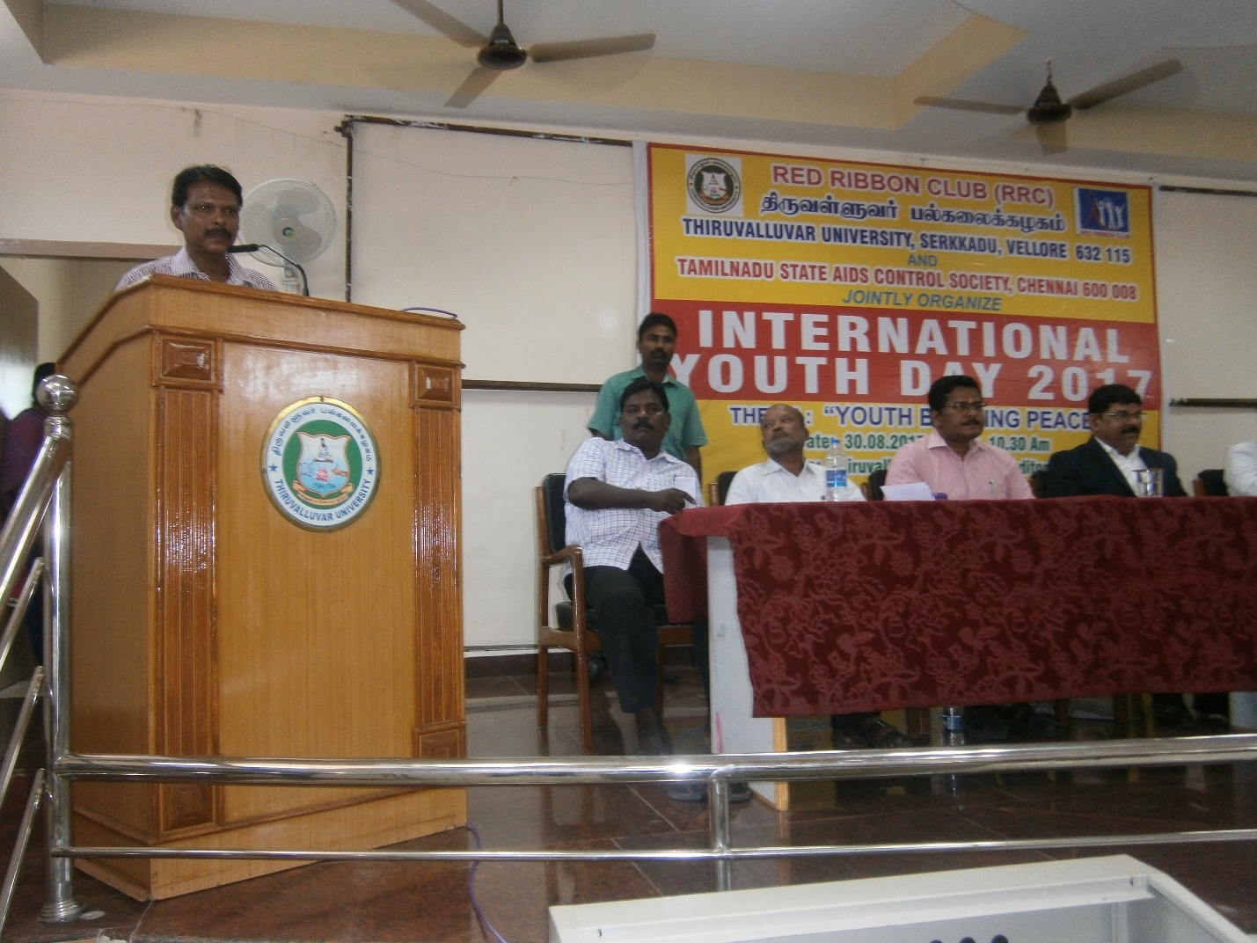
Showing the welcome address of the Programme Coordinator, RRC Dr.K.Sivachandrabose

Slide 9
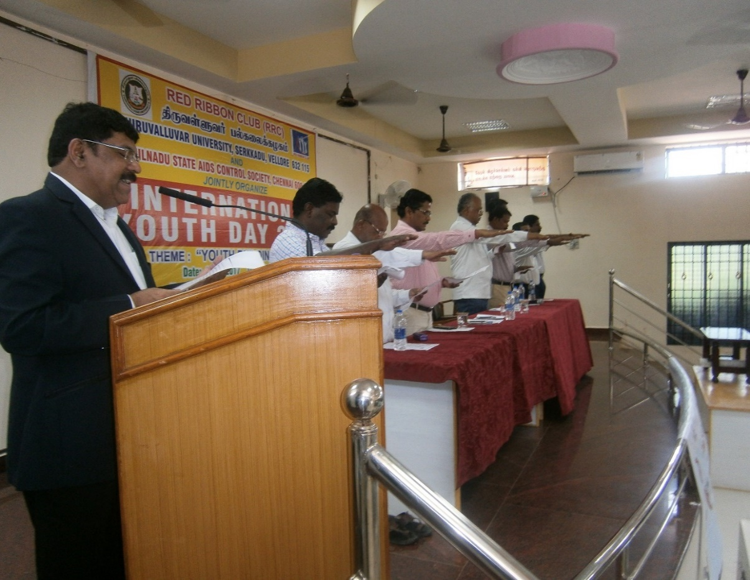
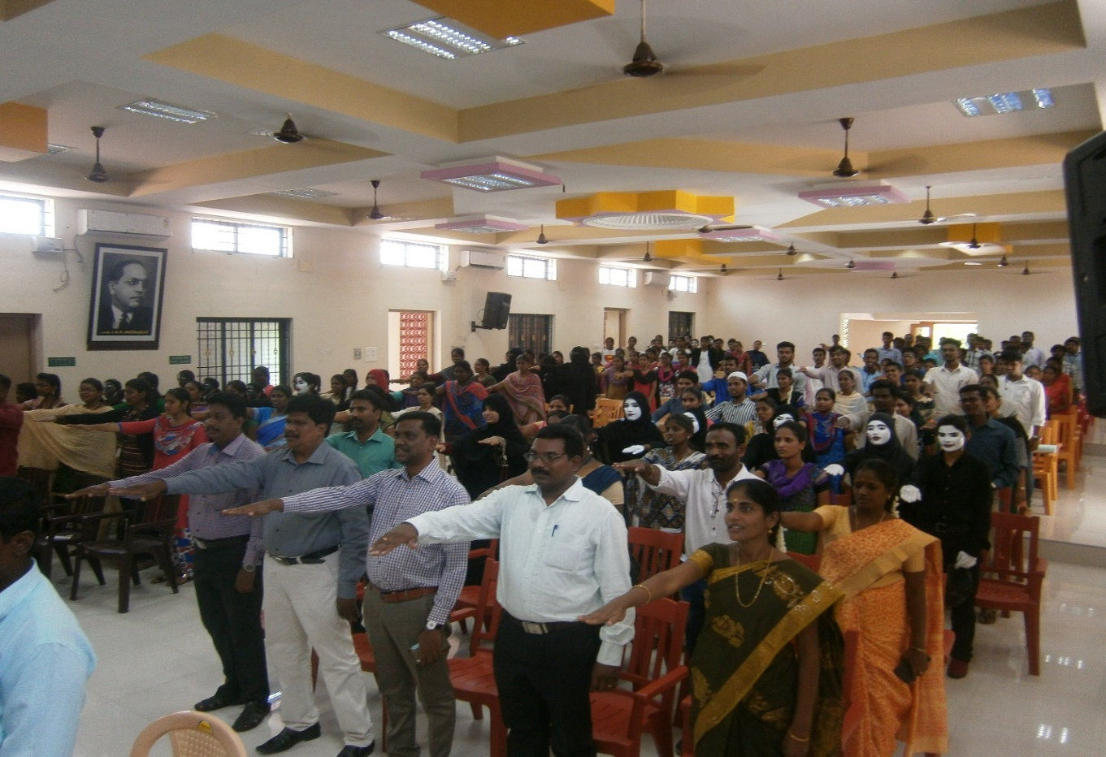
Showing the view of oath taken by participants in the presence of Vice-Chancellor Dr.K.Murugan
Showing the view of oath taken by participants conducted on the behalf of International Youth Day, 2017

Slide 10
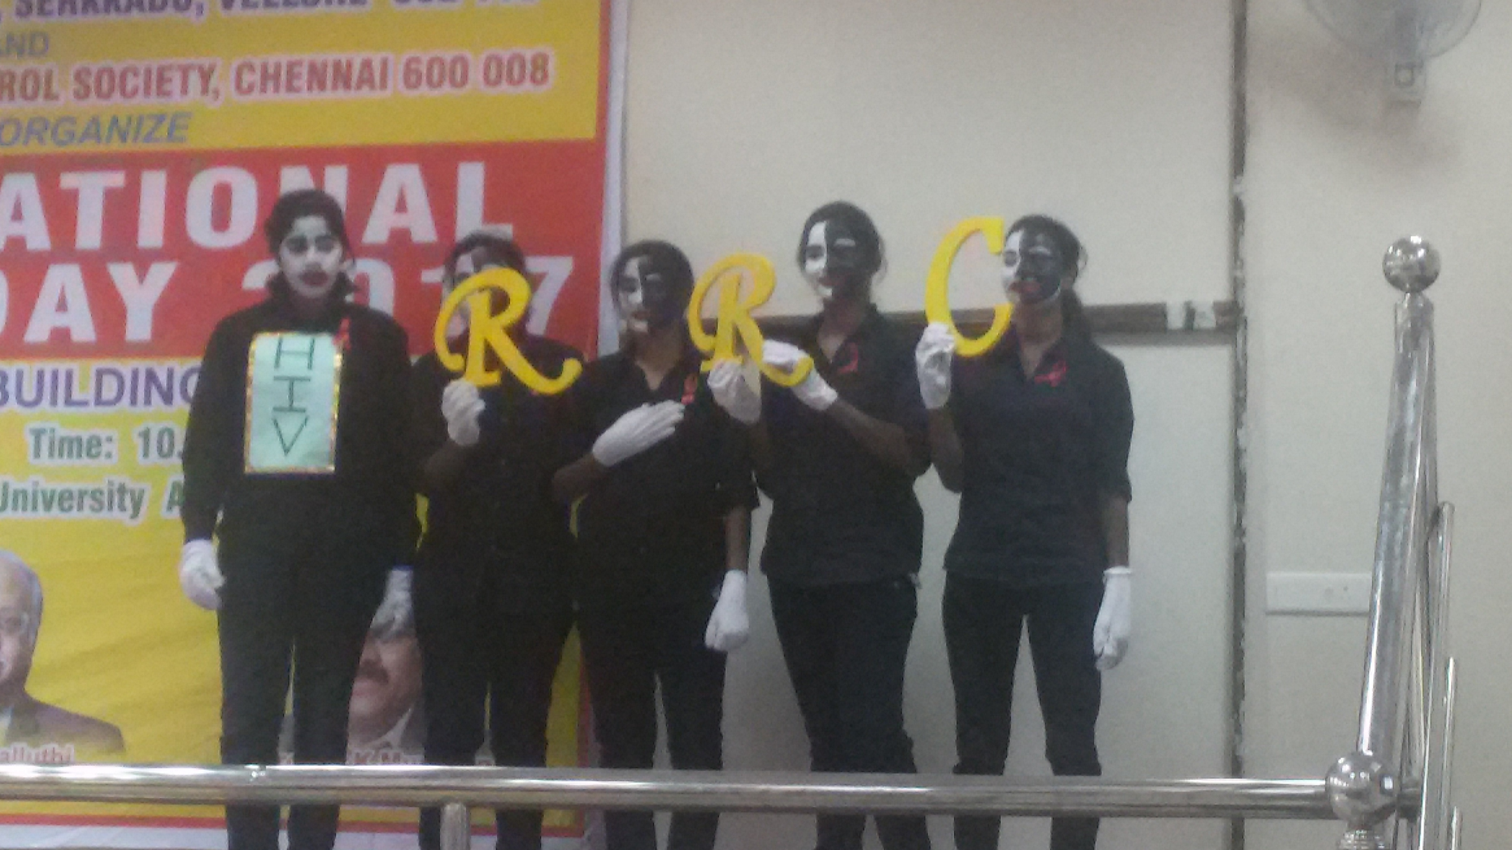
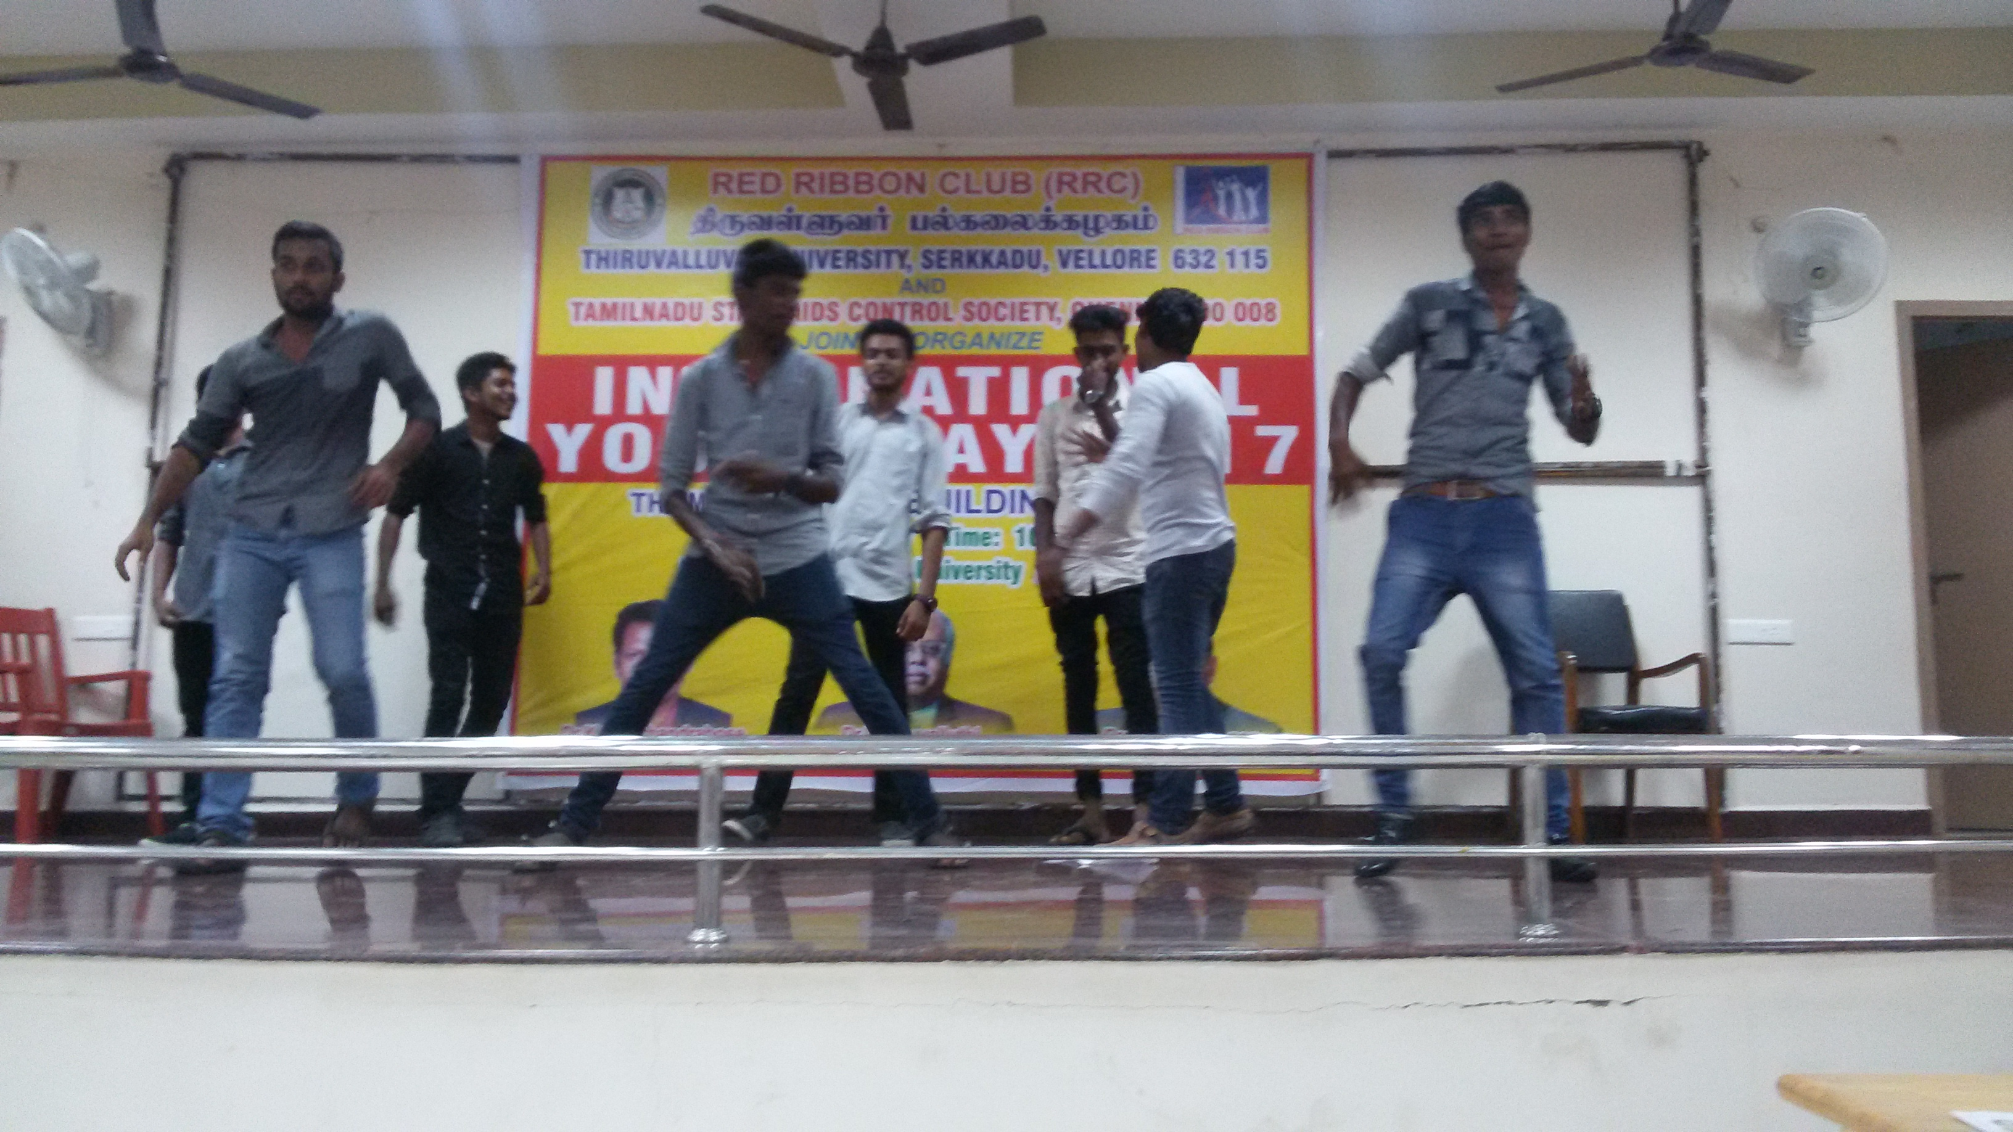
RRC volunteer’s street theatre performance towards eradication of HIV/AIDS
RRC volunteers performance during the event conduct on IYD,2017

Slide 11
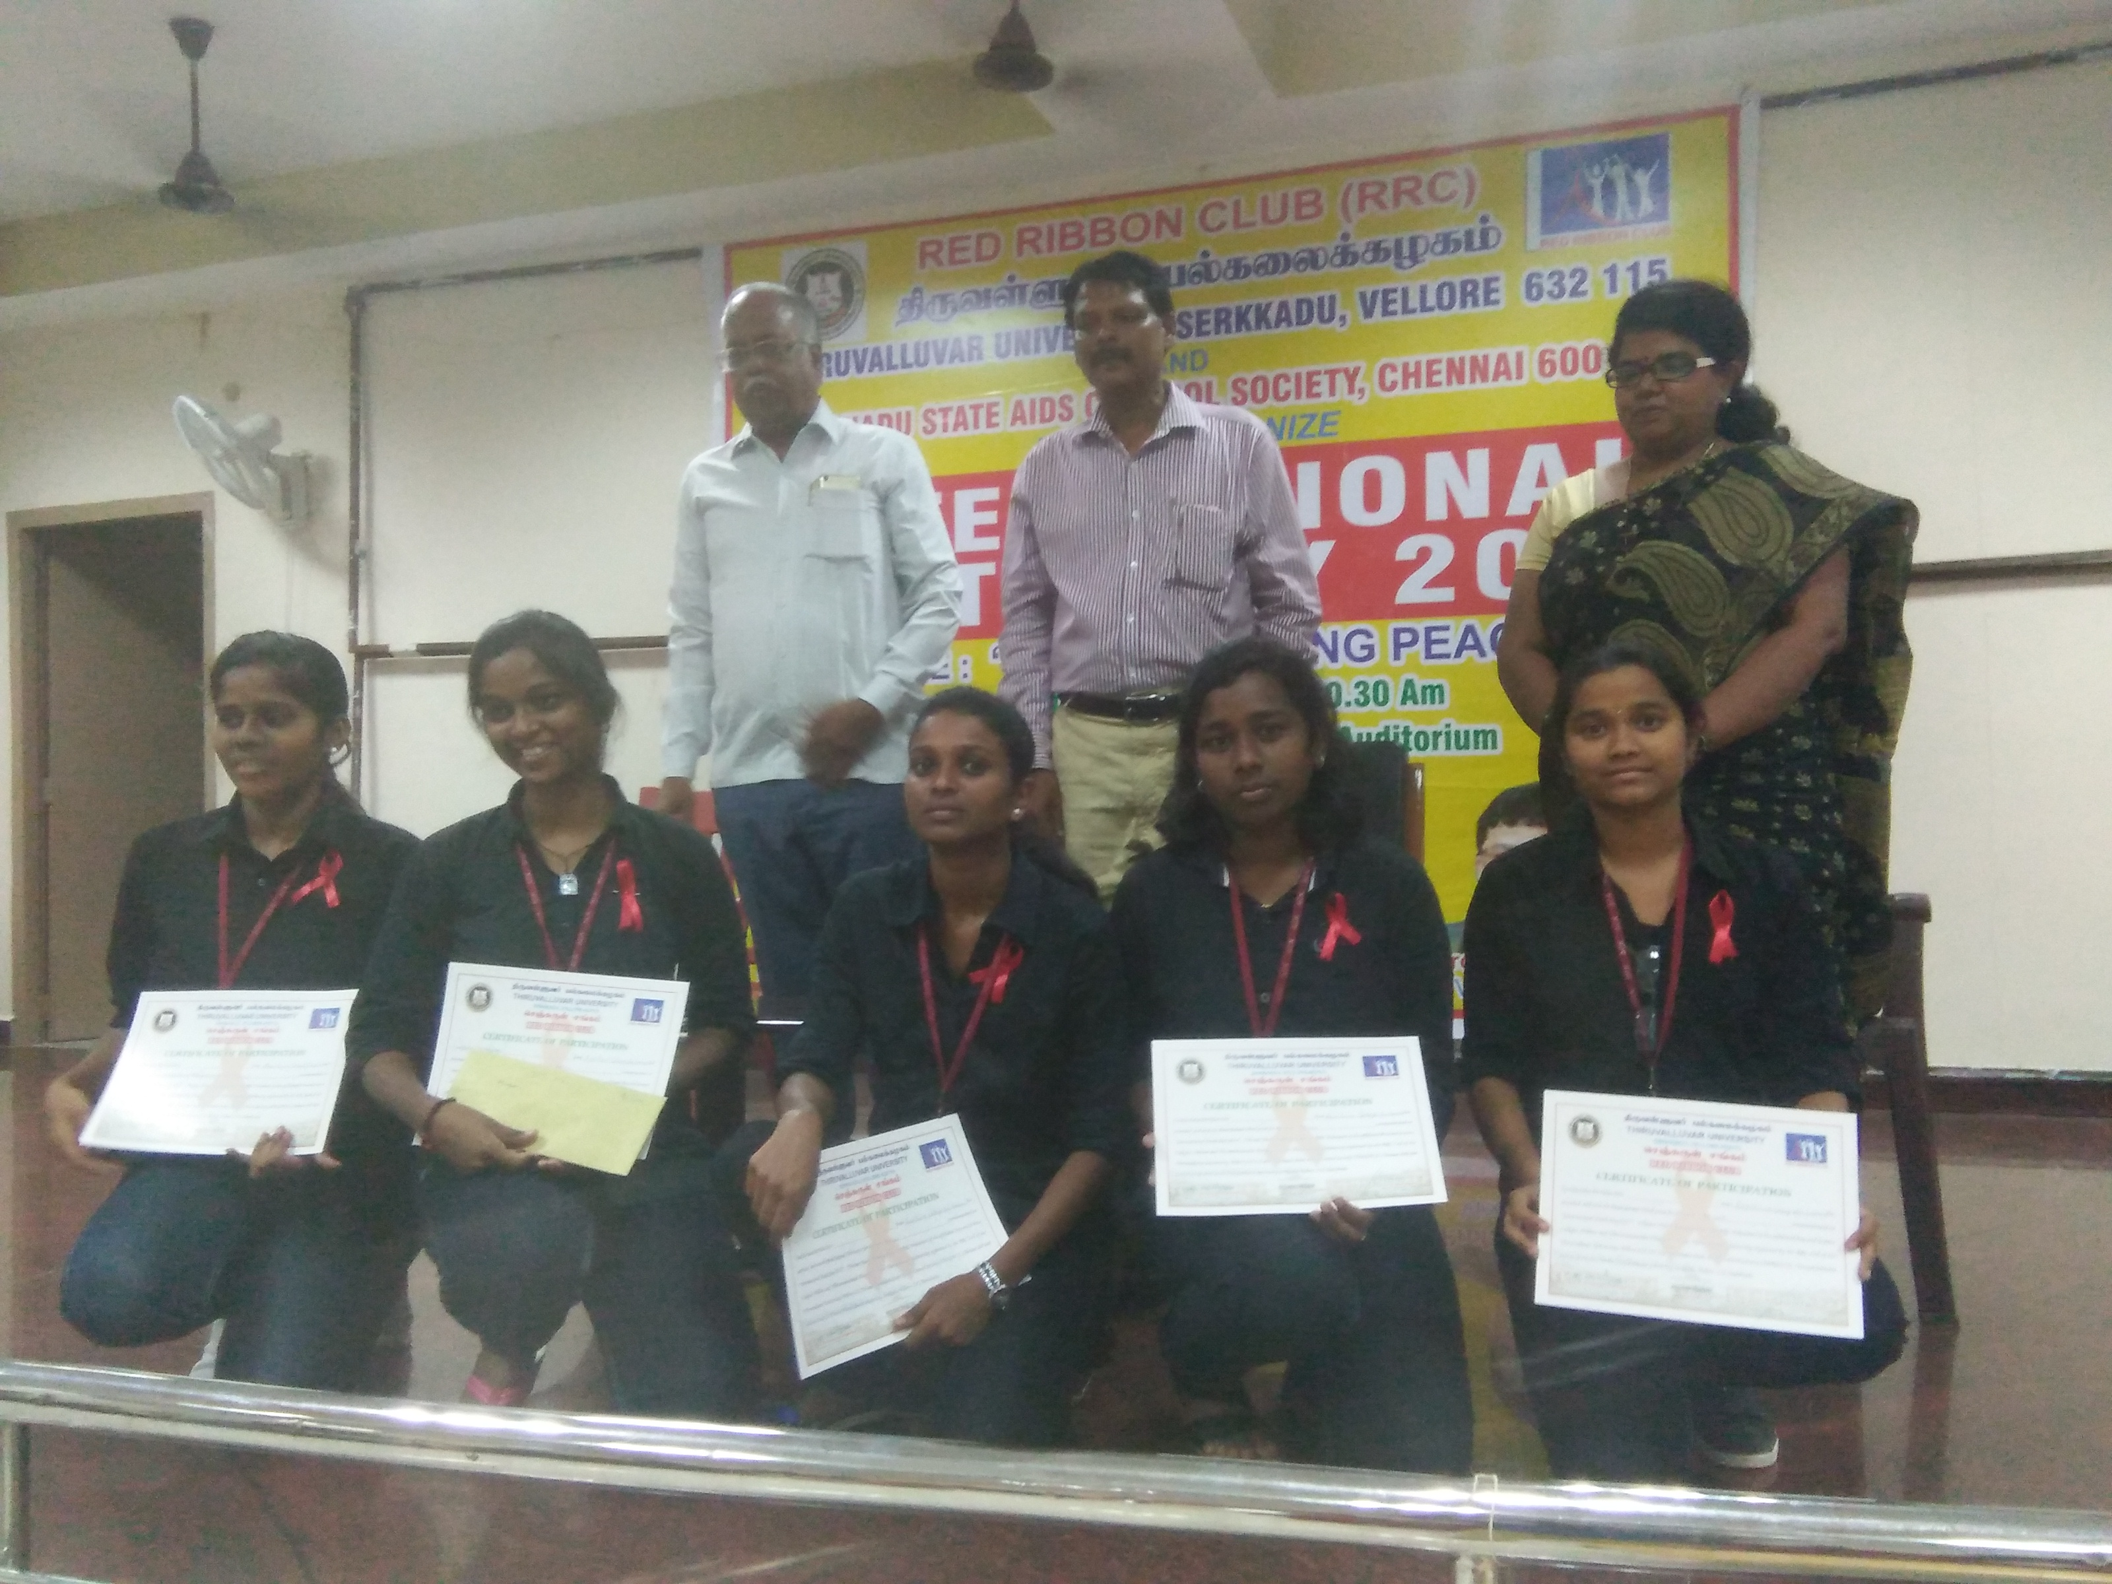
Showing certificate distribution session to the winners of the competition. From the left row: Dr.V.Peruvalluthi, Registrar i/c, Dr.K.Sivachandrabose, Programme Coordinator,RRC, Dr.Amutha, Programme officer,RRC.

Slide 12
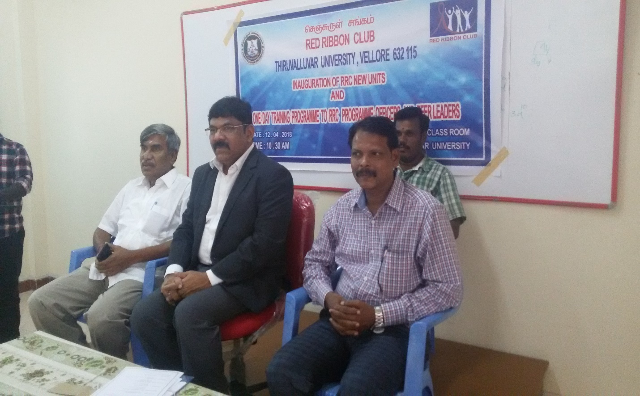
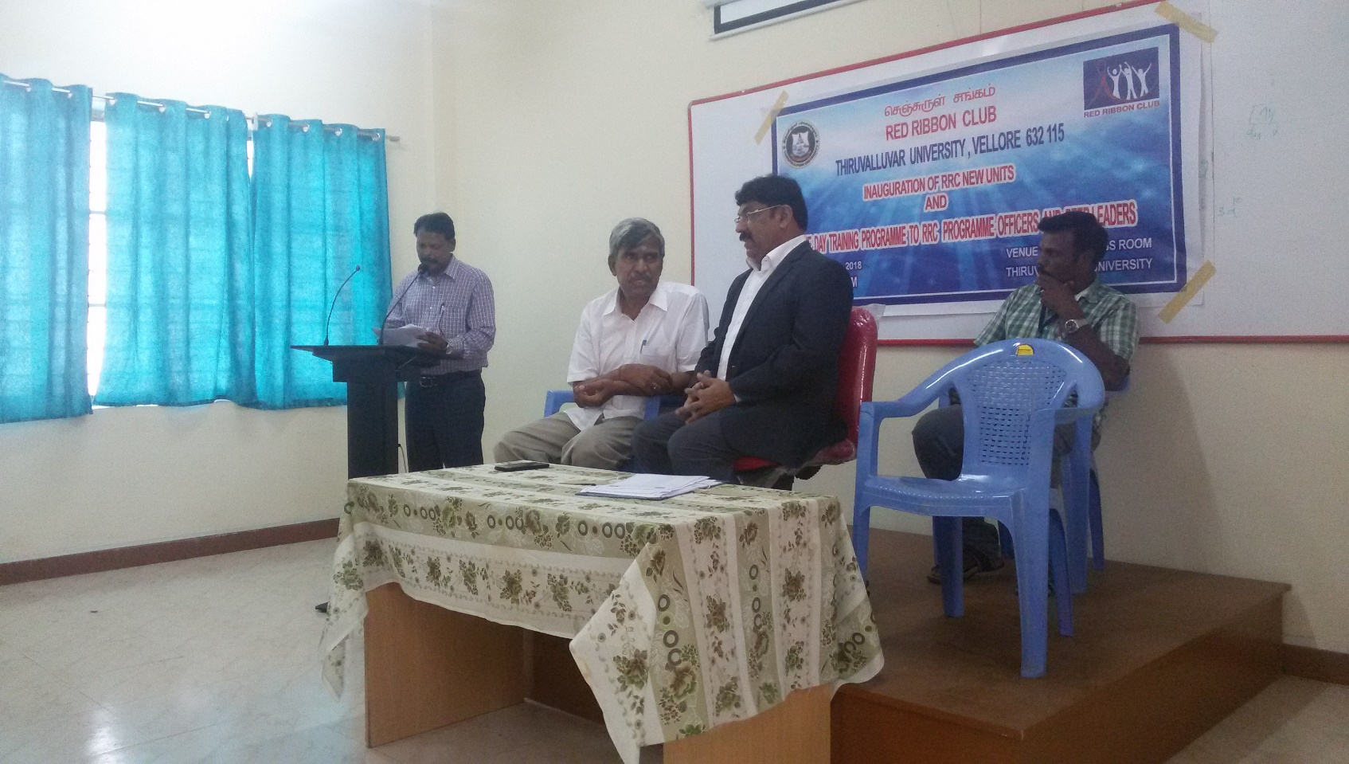
Vice-Chancellor Prof.Dr.K.Murugan,D.Sc along with COE Dr.B.Senthilkumar and RRC Coordinator Dr.K.Sivachandrabose
RRC Coordinator Dr.K.Sivachandrabose welcomed the gathering

Slide 13
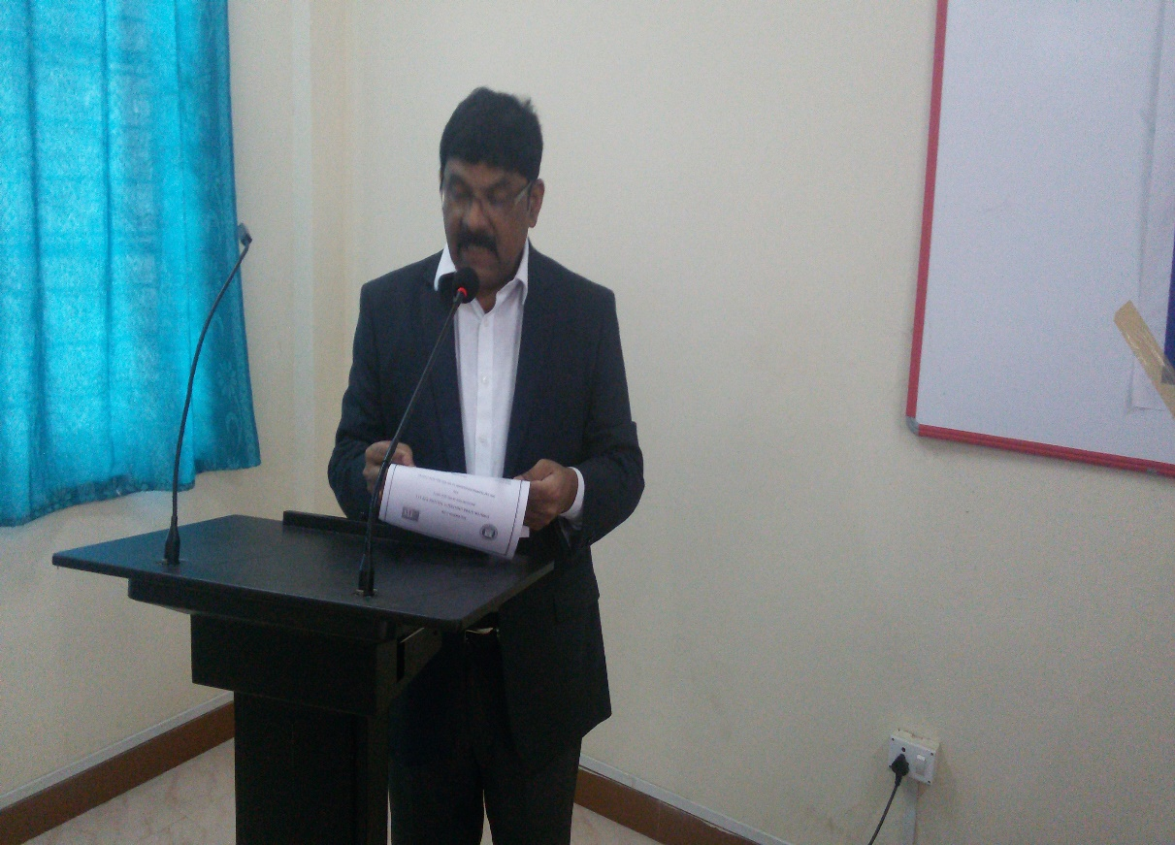
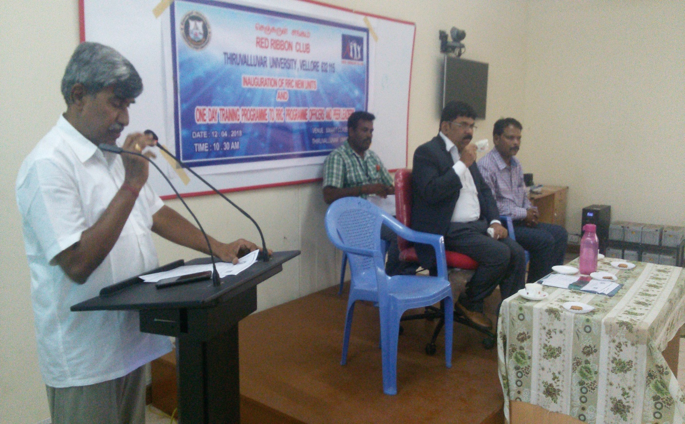
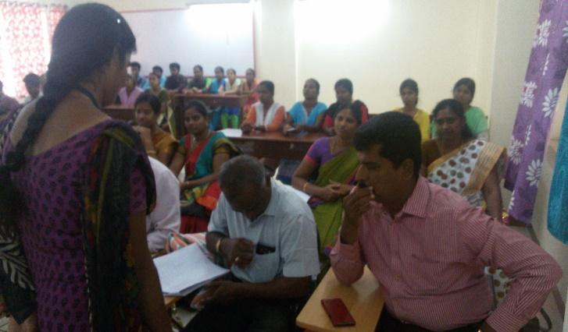
Prof.Dr.K.Murugan,D.Sc Vice-Chancellor of the University created an awareness among the student volunteers through his thought provoking talk
Controller of Examinations Dr.B.Senthilkumar talking on the theme of the meeting
One of the student volunteer Miss Gnanasri took the college list

Slide 14
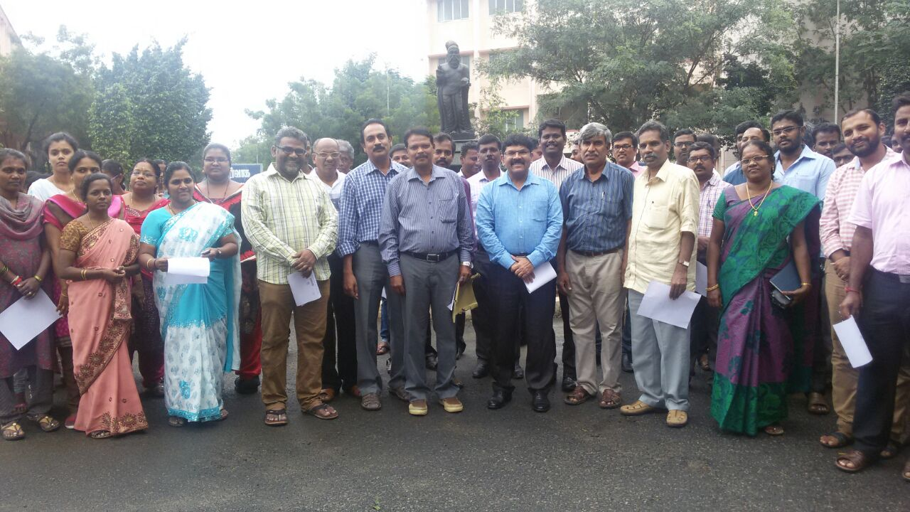
WORLD AIDS DAY OBSERVED ON 1ST DECEMBER,2017

Slide 15
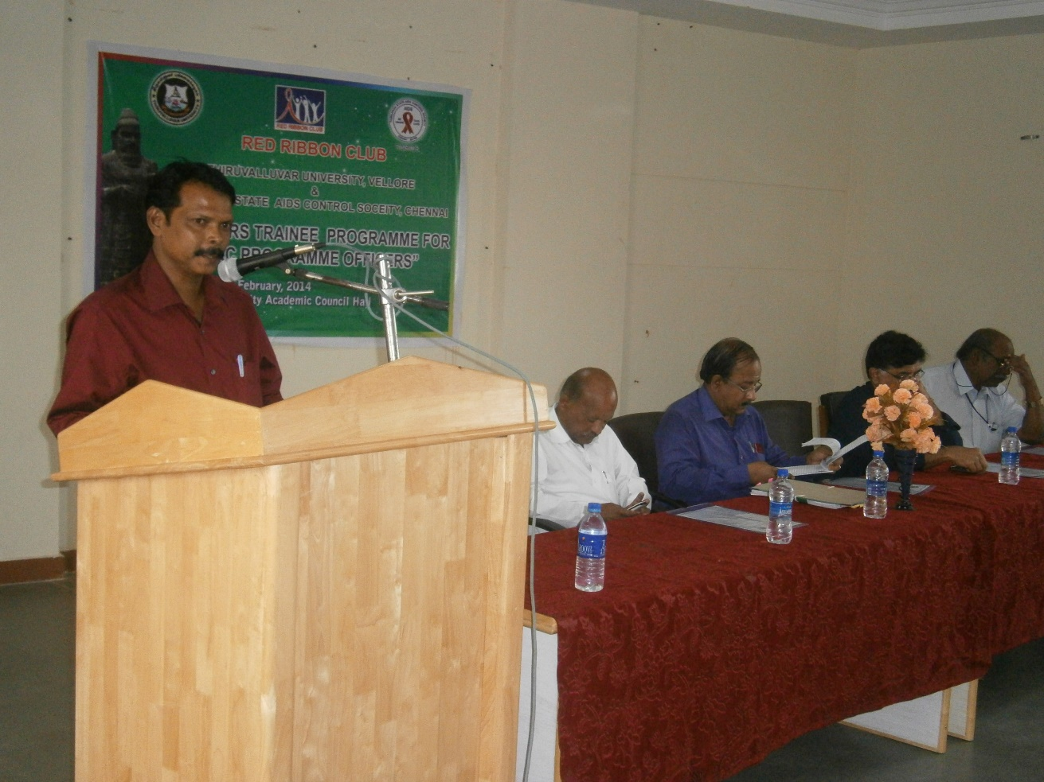
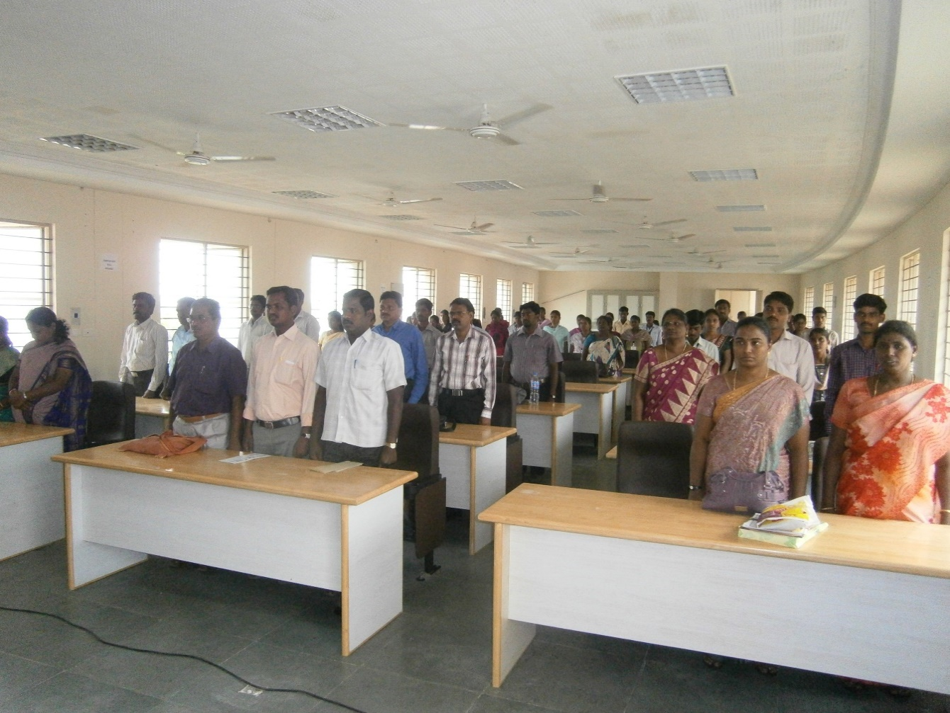
RED RIBBON CLUB (RRC) ACTIVITIES FOR THE YEAR 2014-2015
ONE DAY ENRICHMENT TRAINING PROGRAMME FOR RRC PROGRAMME OFFICERS
DR.K.SIVACHANDRABOSE RRC coordinator spoke on the meeting

Slide 16
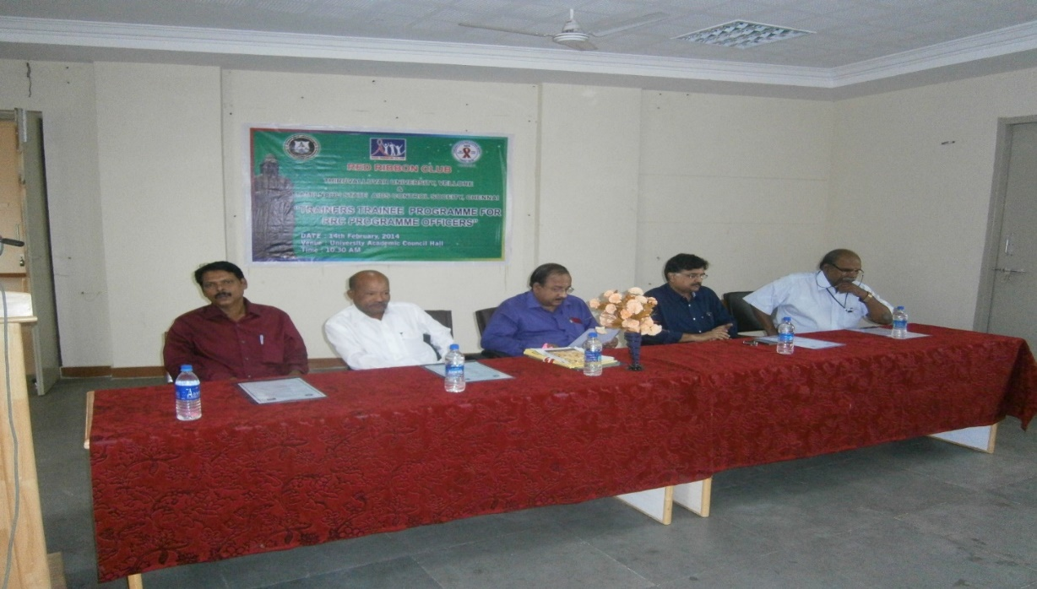
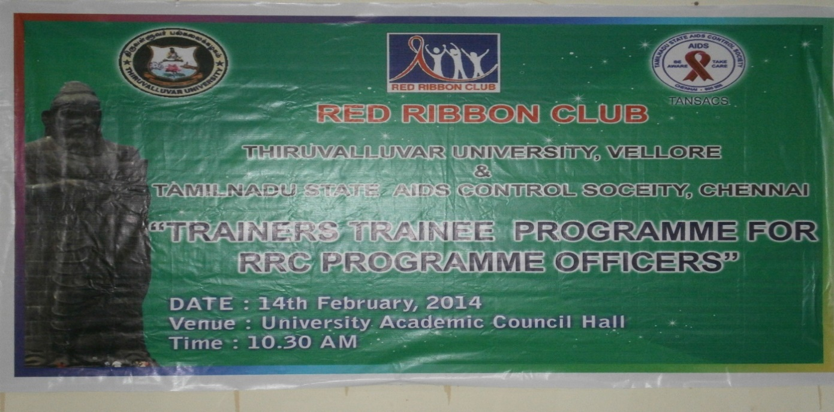
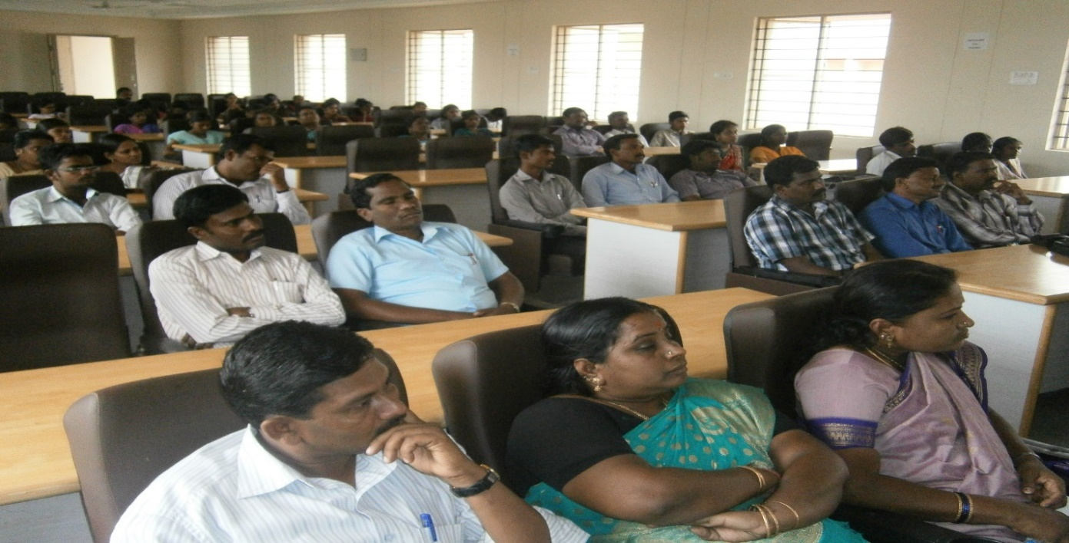
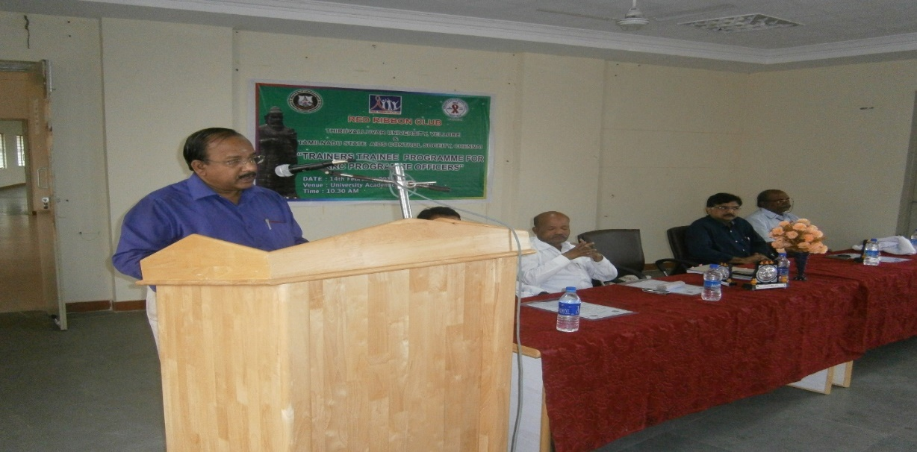
Dignitaries sitting on the dais
DR. JAYAKUMAR, Registrar spoke on the Theme of meeting
View of the RRC POs

Slide 17
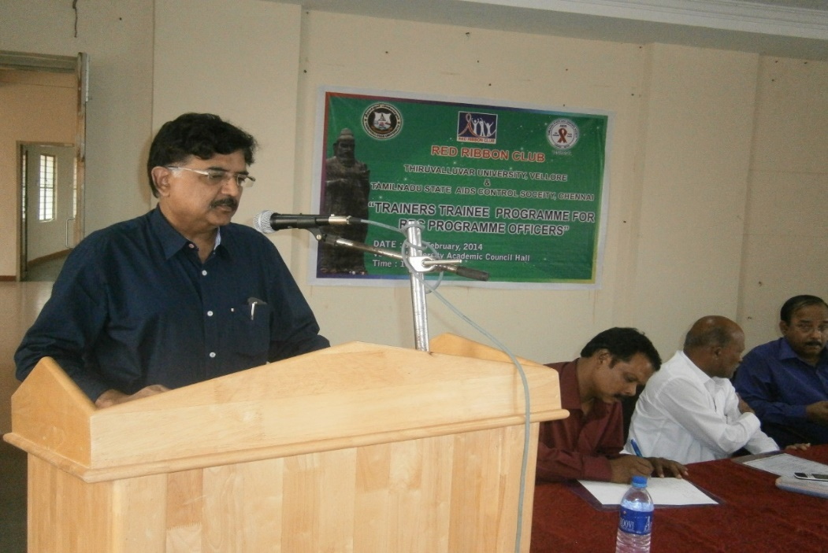
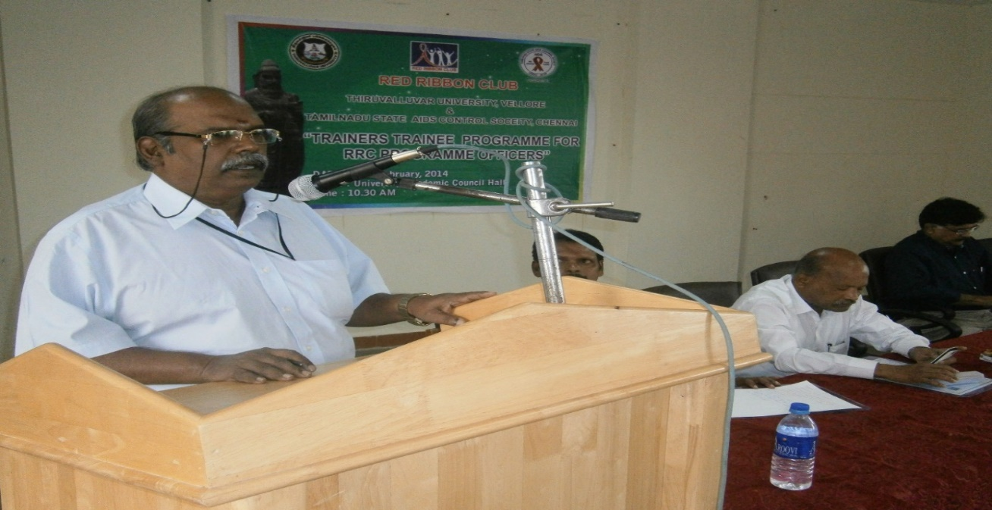
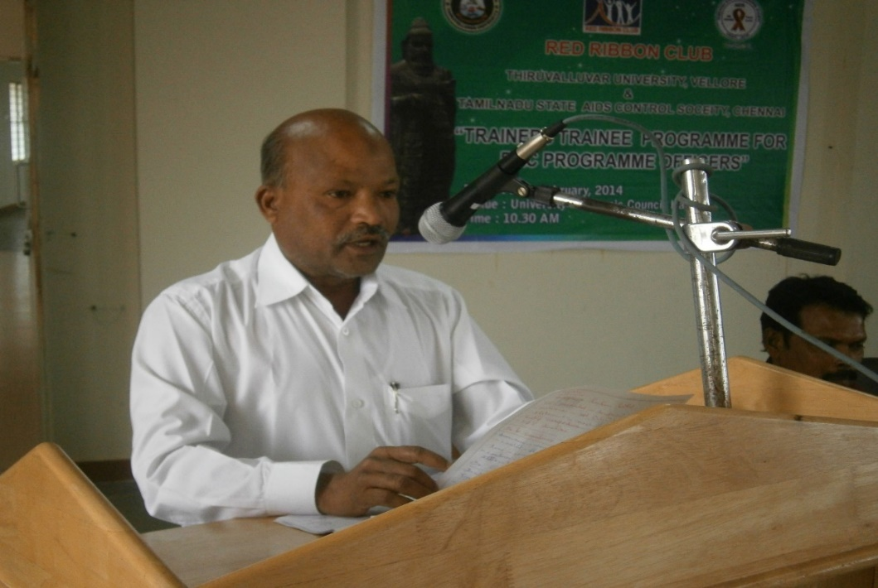
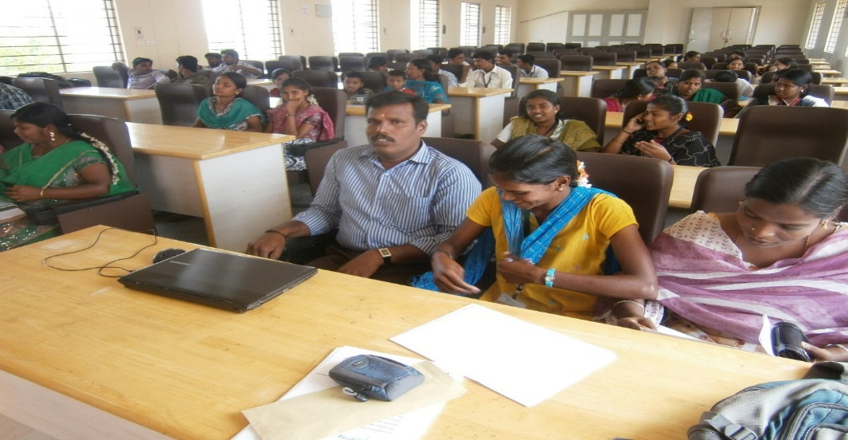
Dr.E.Sivakumar,M.S (ENT) spoke on HIV/AIDS/STI and sex and sexuality
Syndicate member (former) Dr.Munavar jan spoke awareness on RRC
Resource person address on HIV/AIDS impact in the society
View of Student volunteers participated

Slide 18
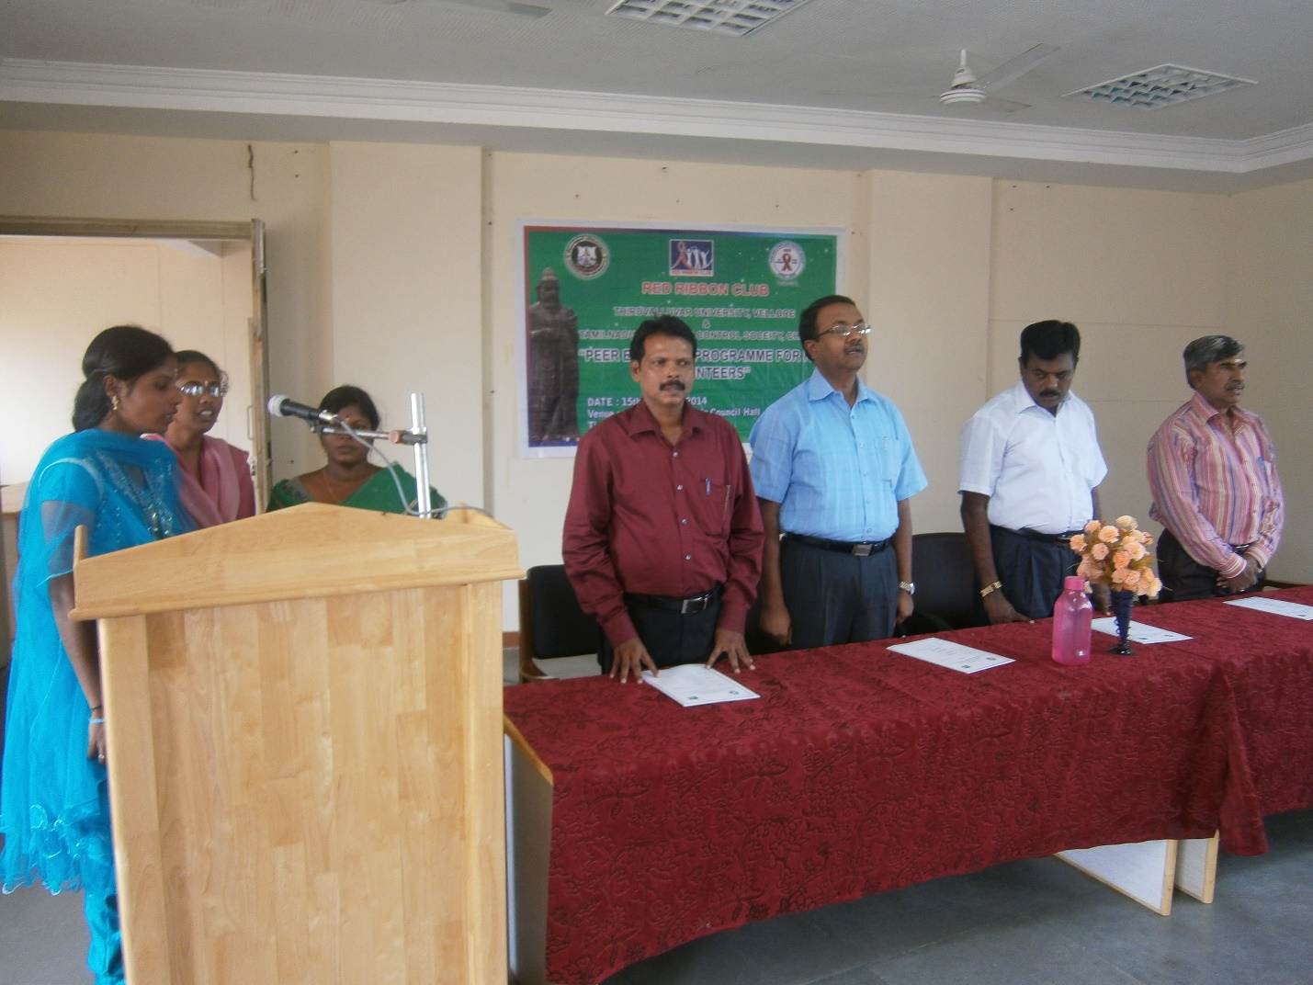
Invocation ‘ Thamizhthai vazhthu’

Slide 19
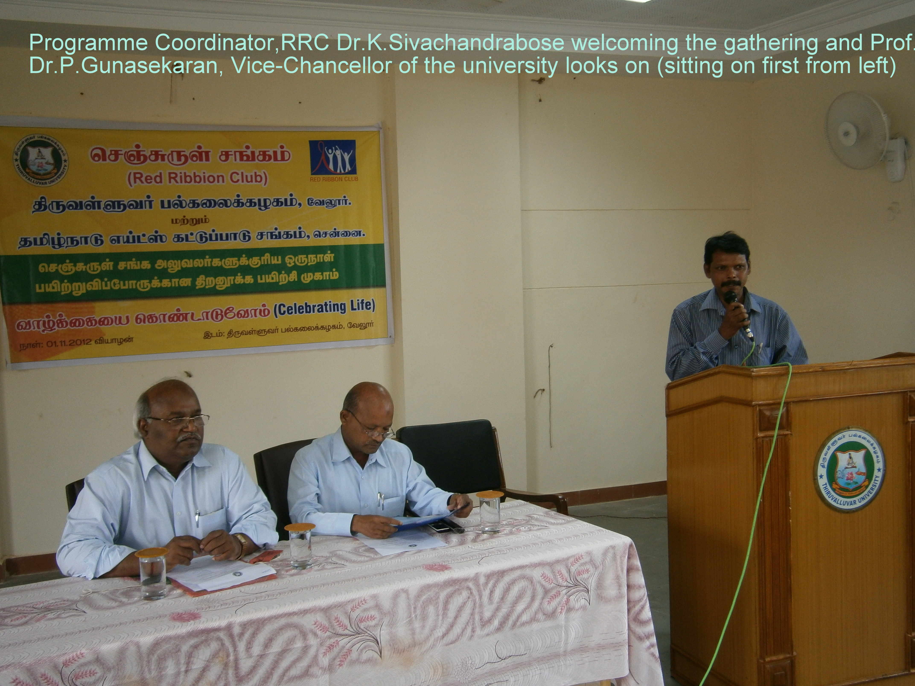
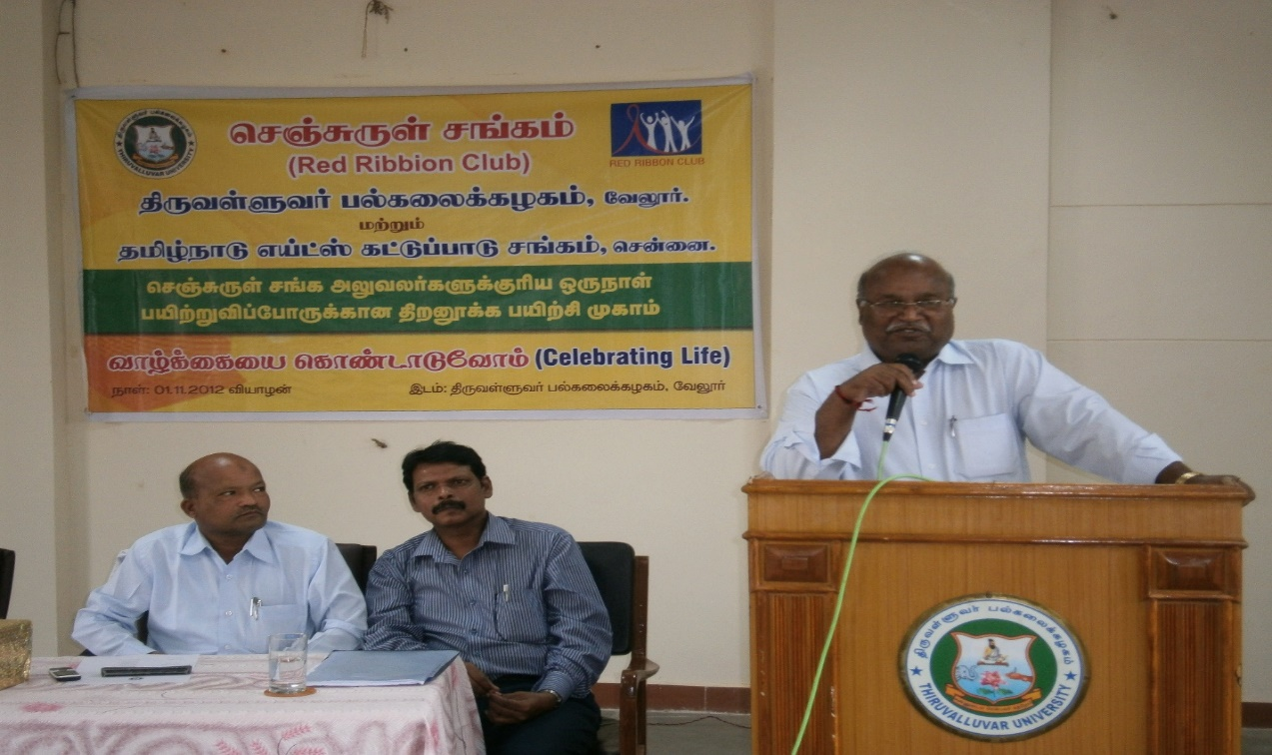
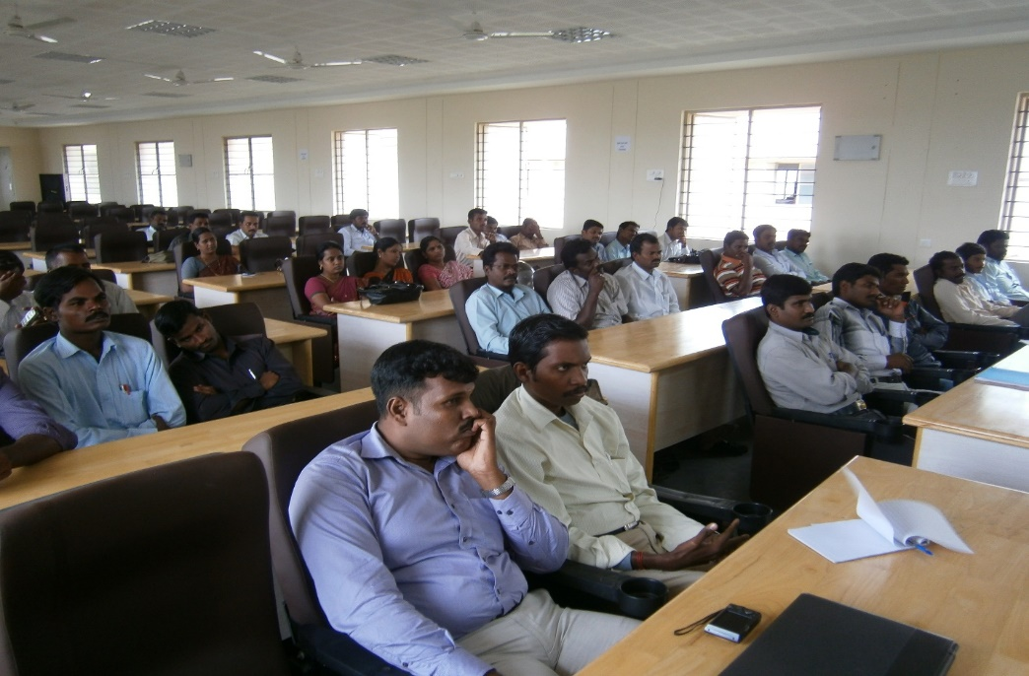
RED RIBBON CLUB (RRC) ACTIVITIES FOR THE 2012-2013
Prof.Dr.P.Gunasekaran,D.Sc Vice-chancellor spoke on the theme of meeting
View of resource persons and participants attended

Slide 20
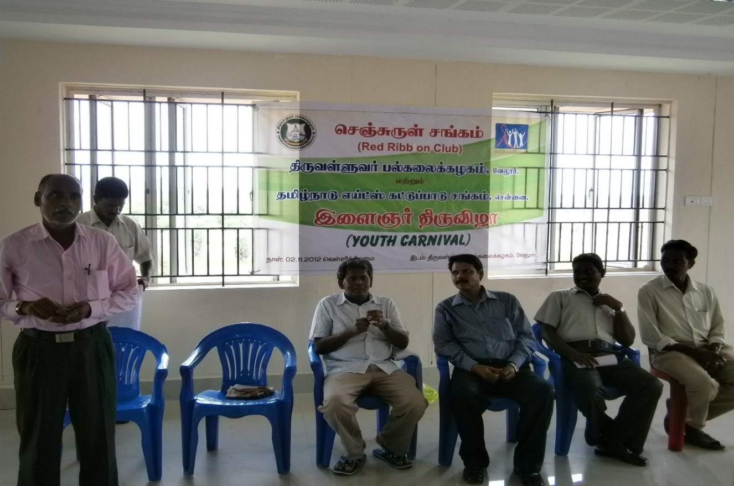
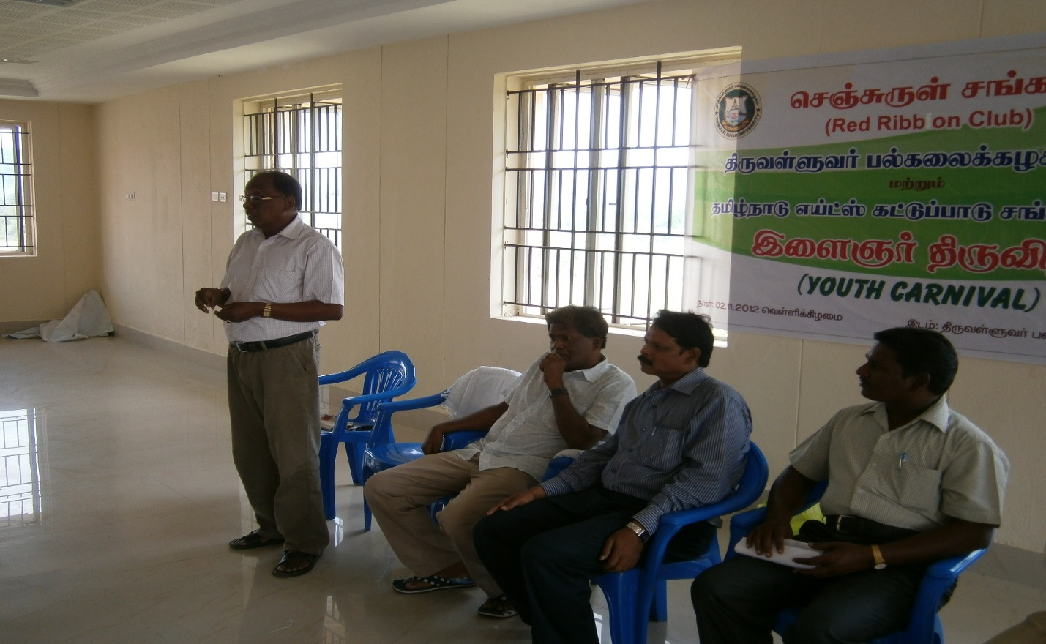
COMMEMORATION OF YOUTH CARNIVAL 2014 FOR RRC VOLUNTEERS
RRC Po Thiru Gunasekaran spoke on the meeting
Prof.Dr.Shafi spoke on the meeting

Slide 21
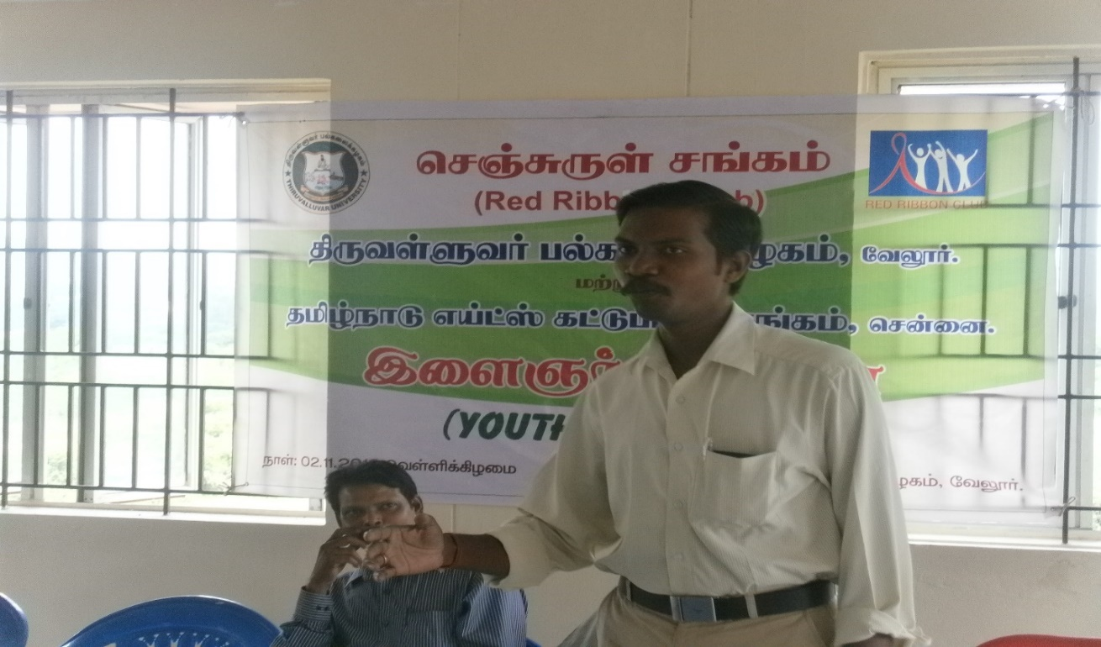
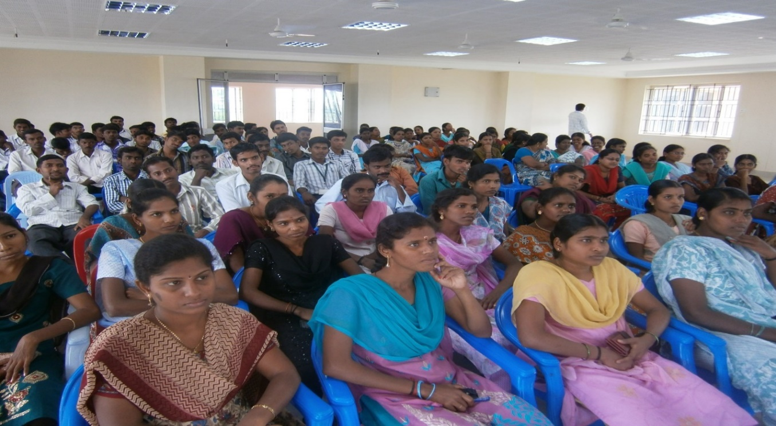
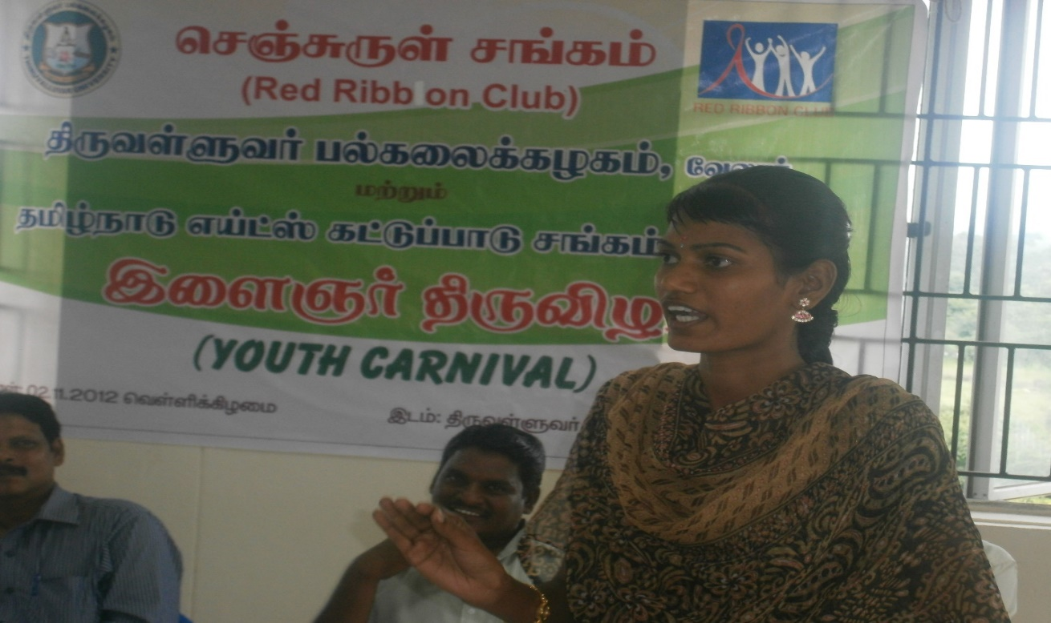
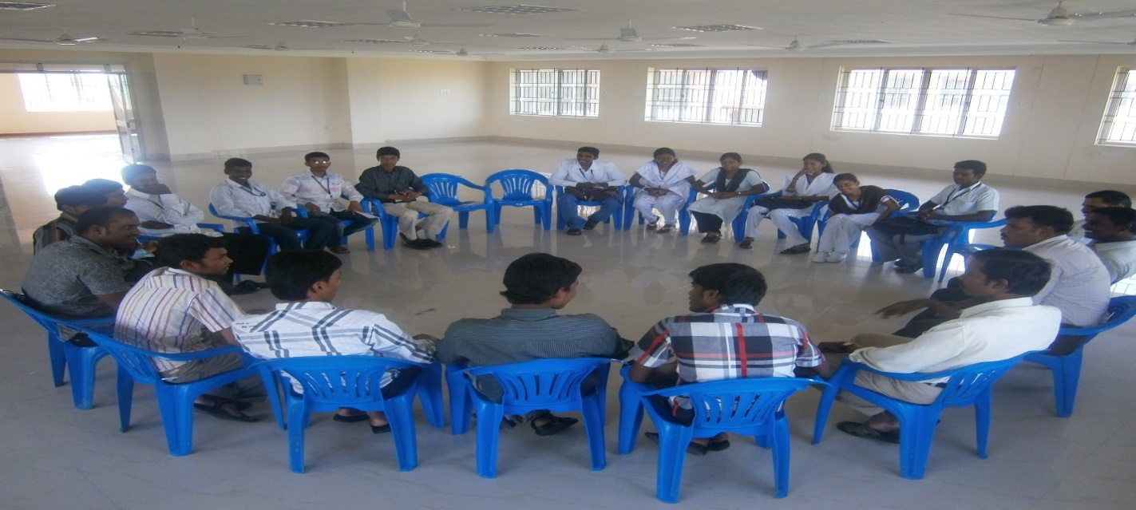
District RRC Manager Mr. Kathiravan spoke on the Theme
View of Student volunteers curiously watching the address
Miss Jayanthi, student volunteer interacting with resource person
Group discussion with resource persons and volunteers

Slide 22
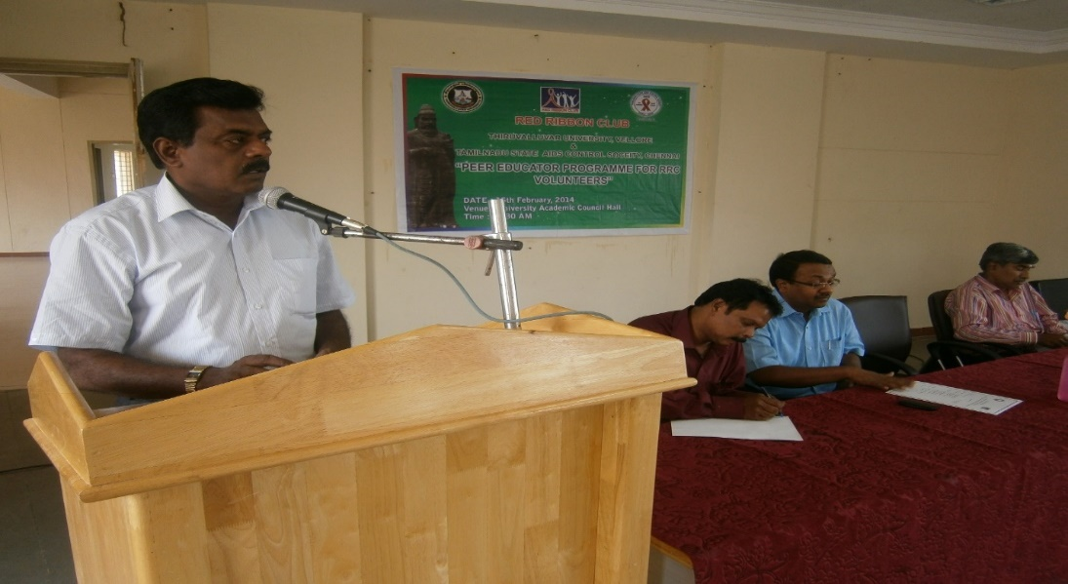
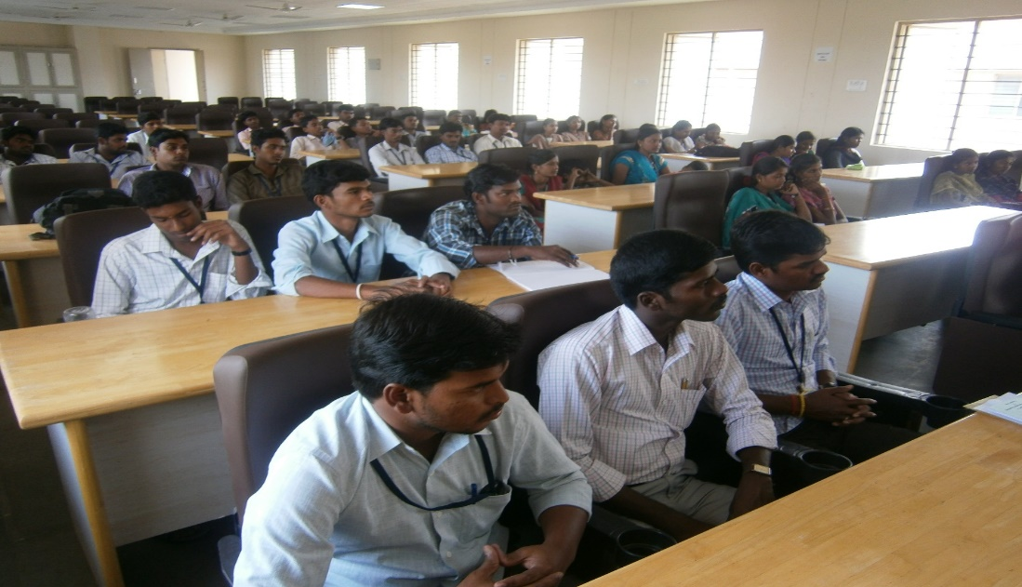
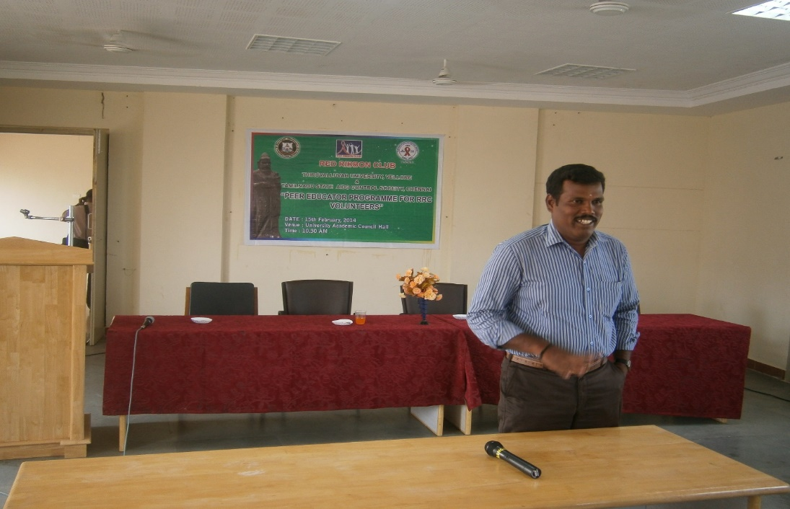
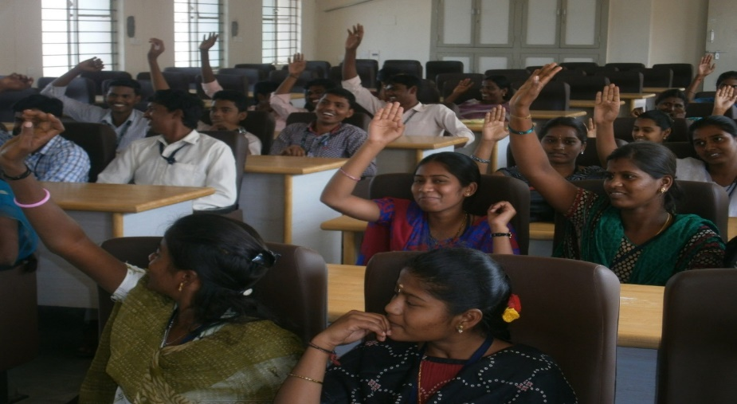
PEER EDUCATOR TRAINING PROGRAMME FOR RRC VOLUNTEERS FOR THE YEAR 2014-‘15
Dr.Ashokan, controller of Examinations narrated about the meeting
View of student volunteers
District RRC Manager Mr.Rajendran took the training programme
Response of student volunteers

Slide 23
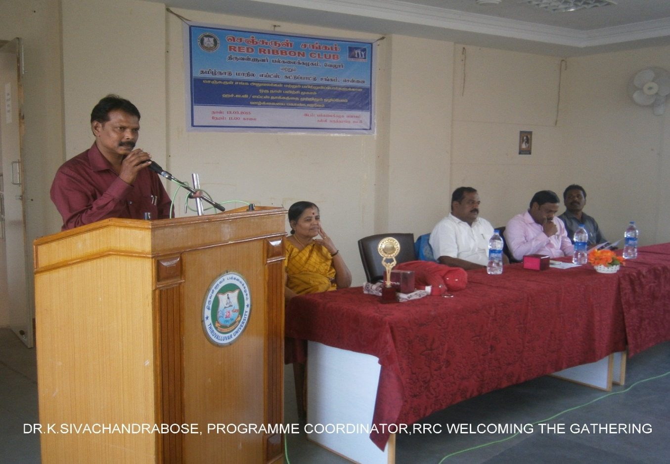
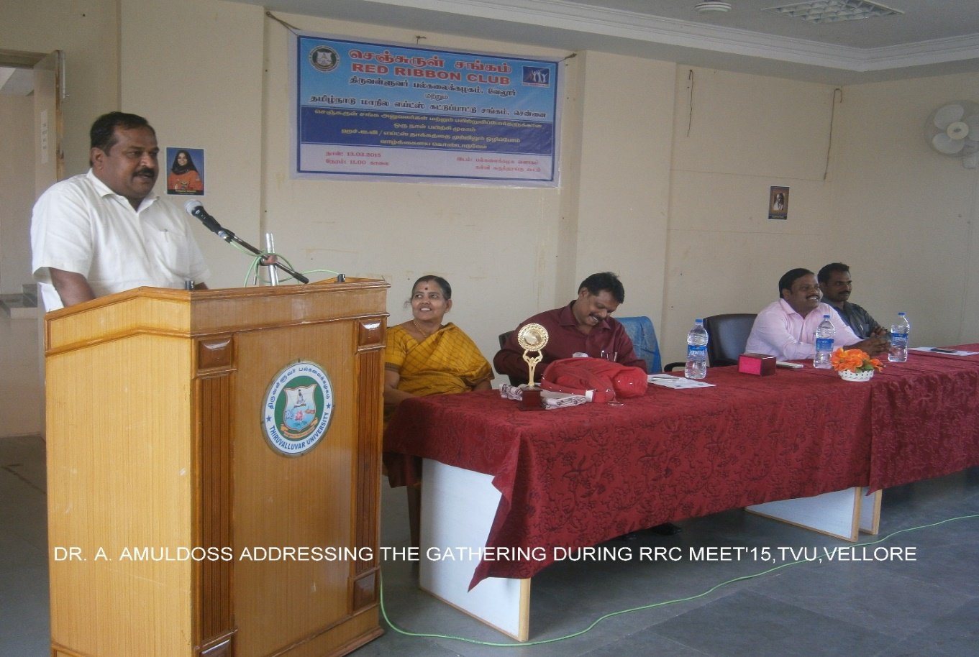
RED RIBBON CLUB ACTIVITIES (RRC) FOR THE 2015-2016
RRC Programme Officers and Volunteers training programme

Slide 24
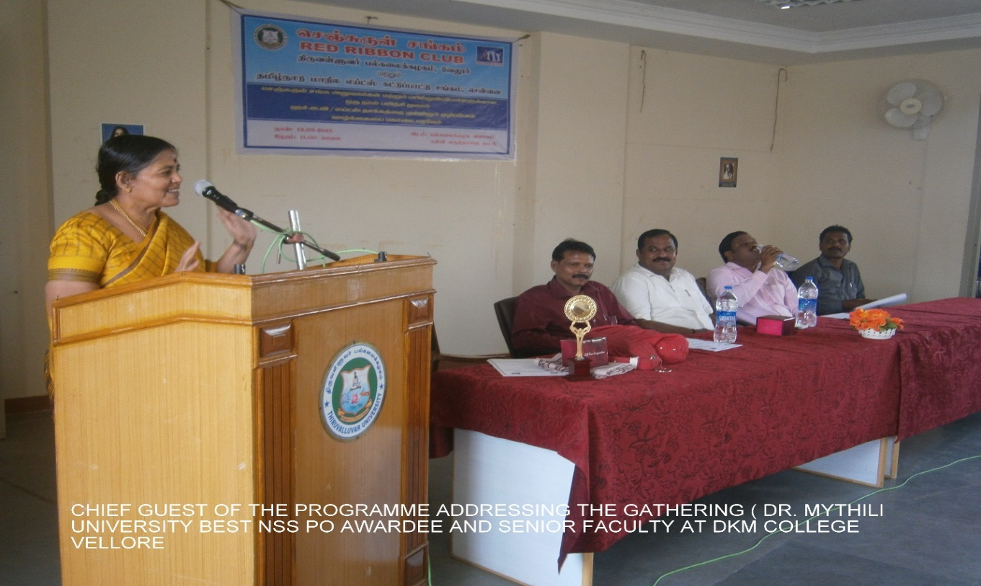
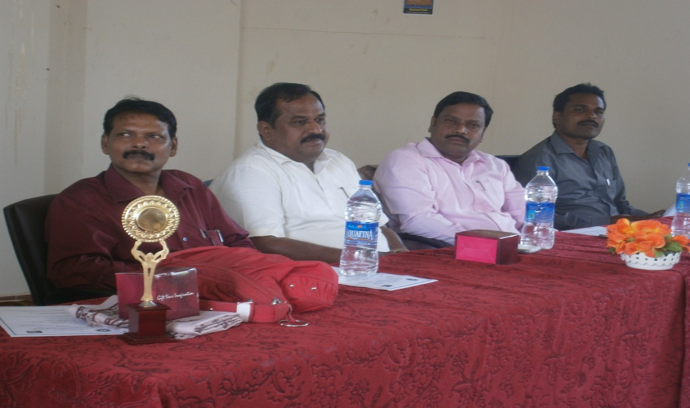
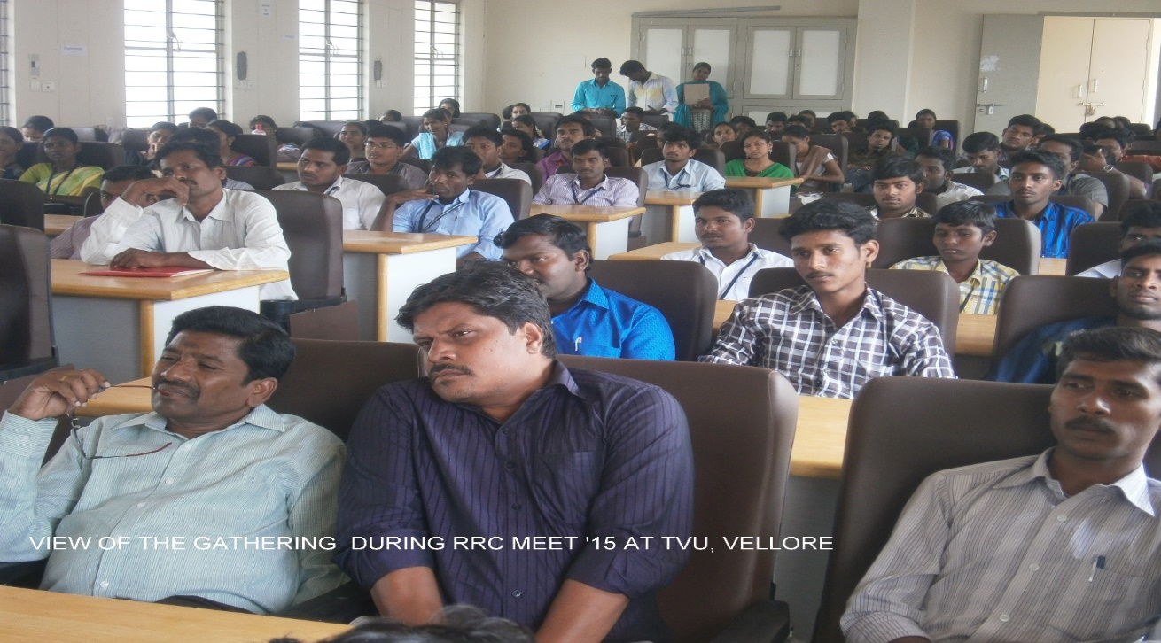
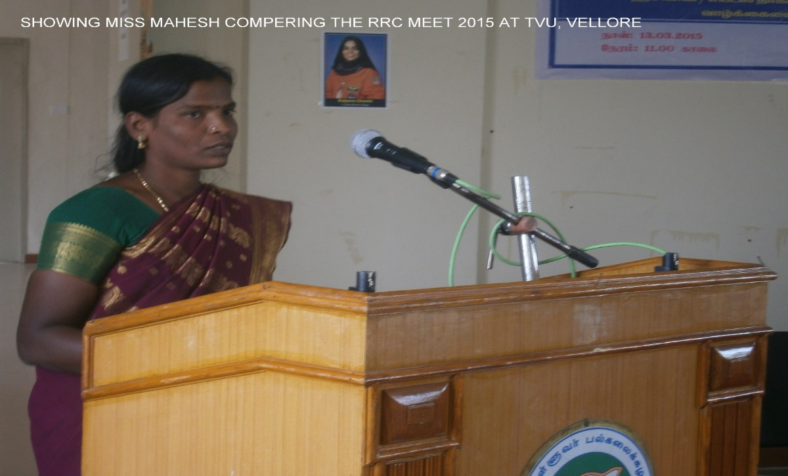

Slide 25
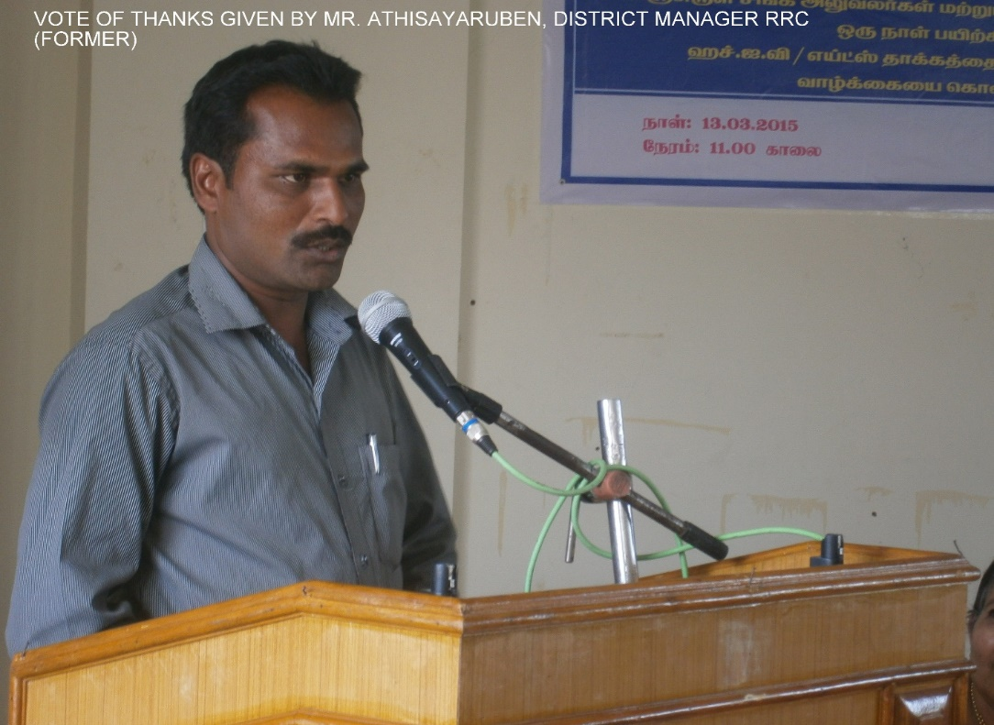
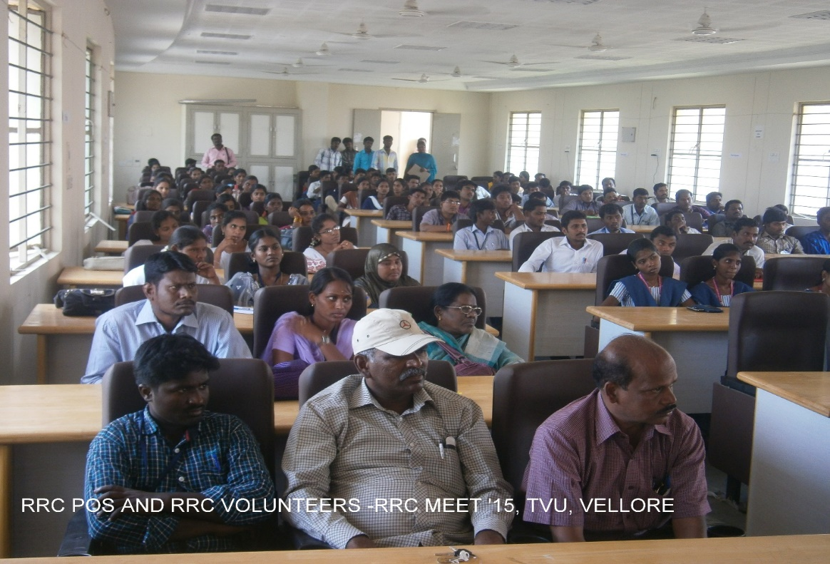
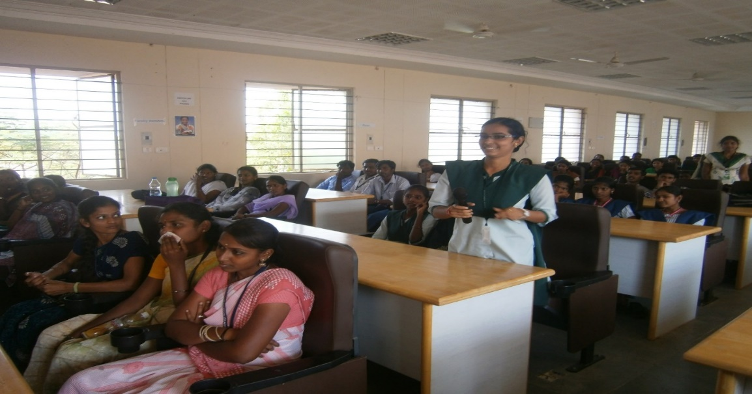
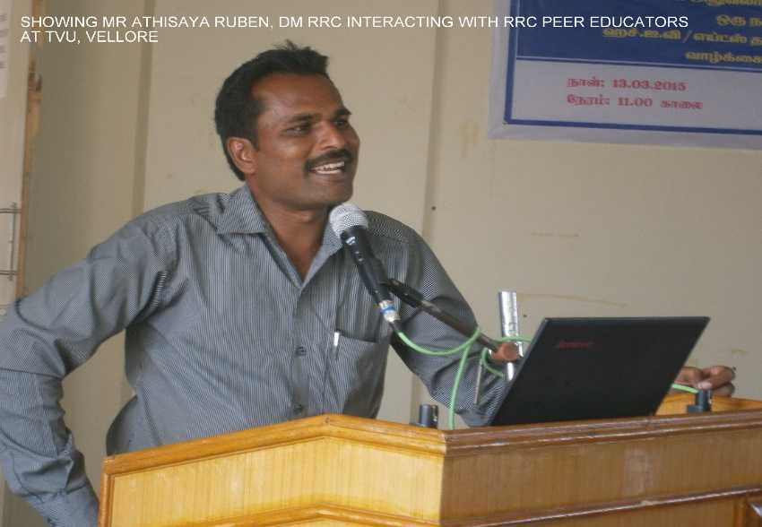
2) Peer Educator training programme for RRC Volunteers
Interaction of student volunteers

Slide 26
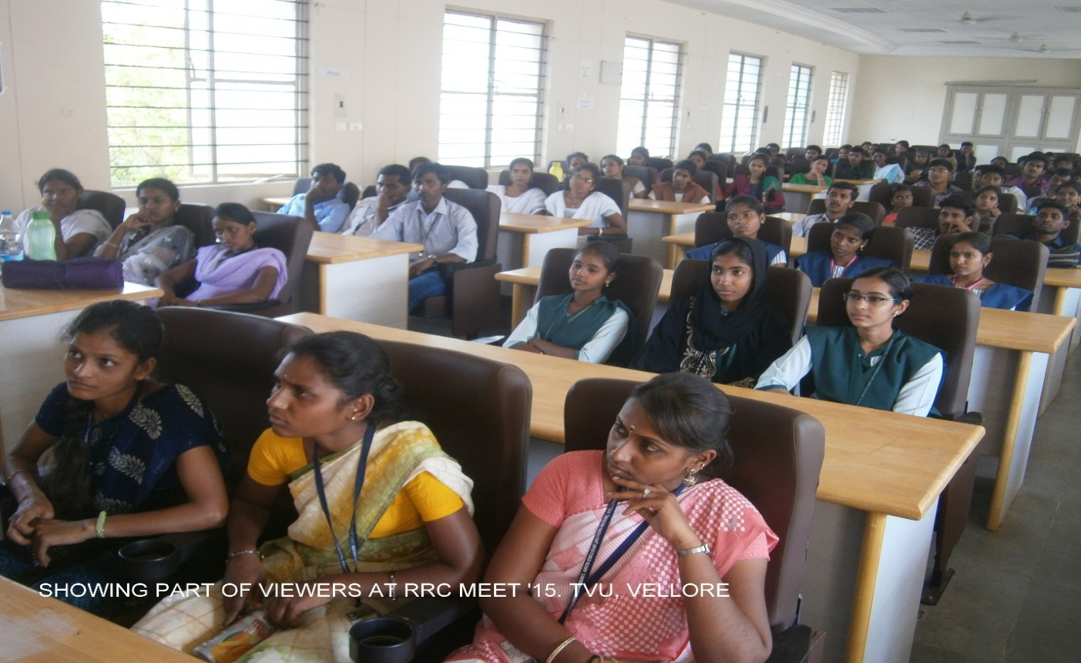



Brain storming session made by RRC Programme Coordinator Dr.K.Sivachandrabose

Slide 27



